Slide 1
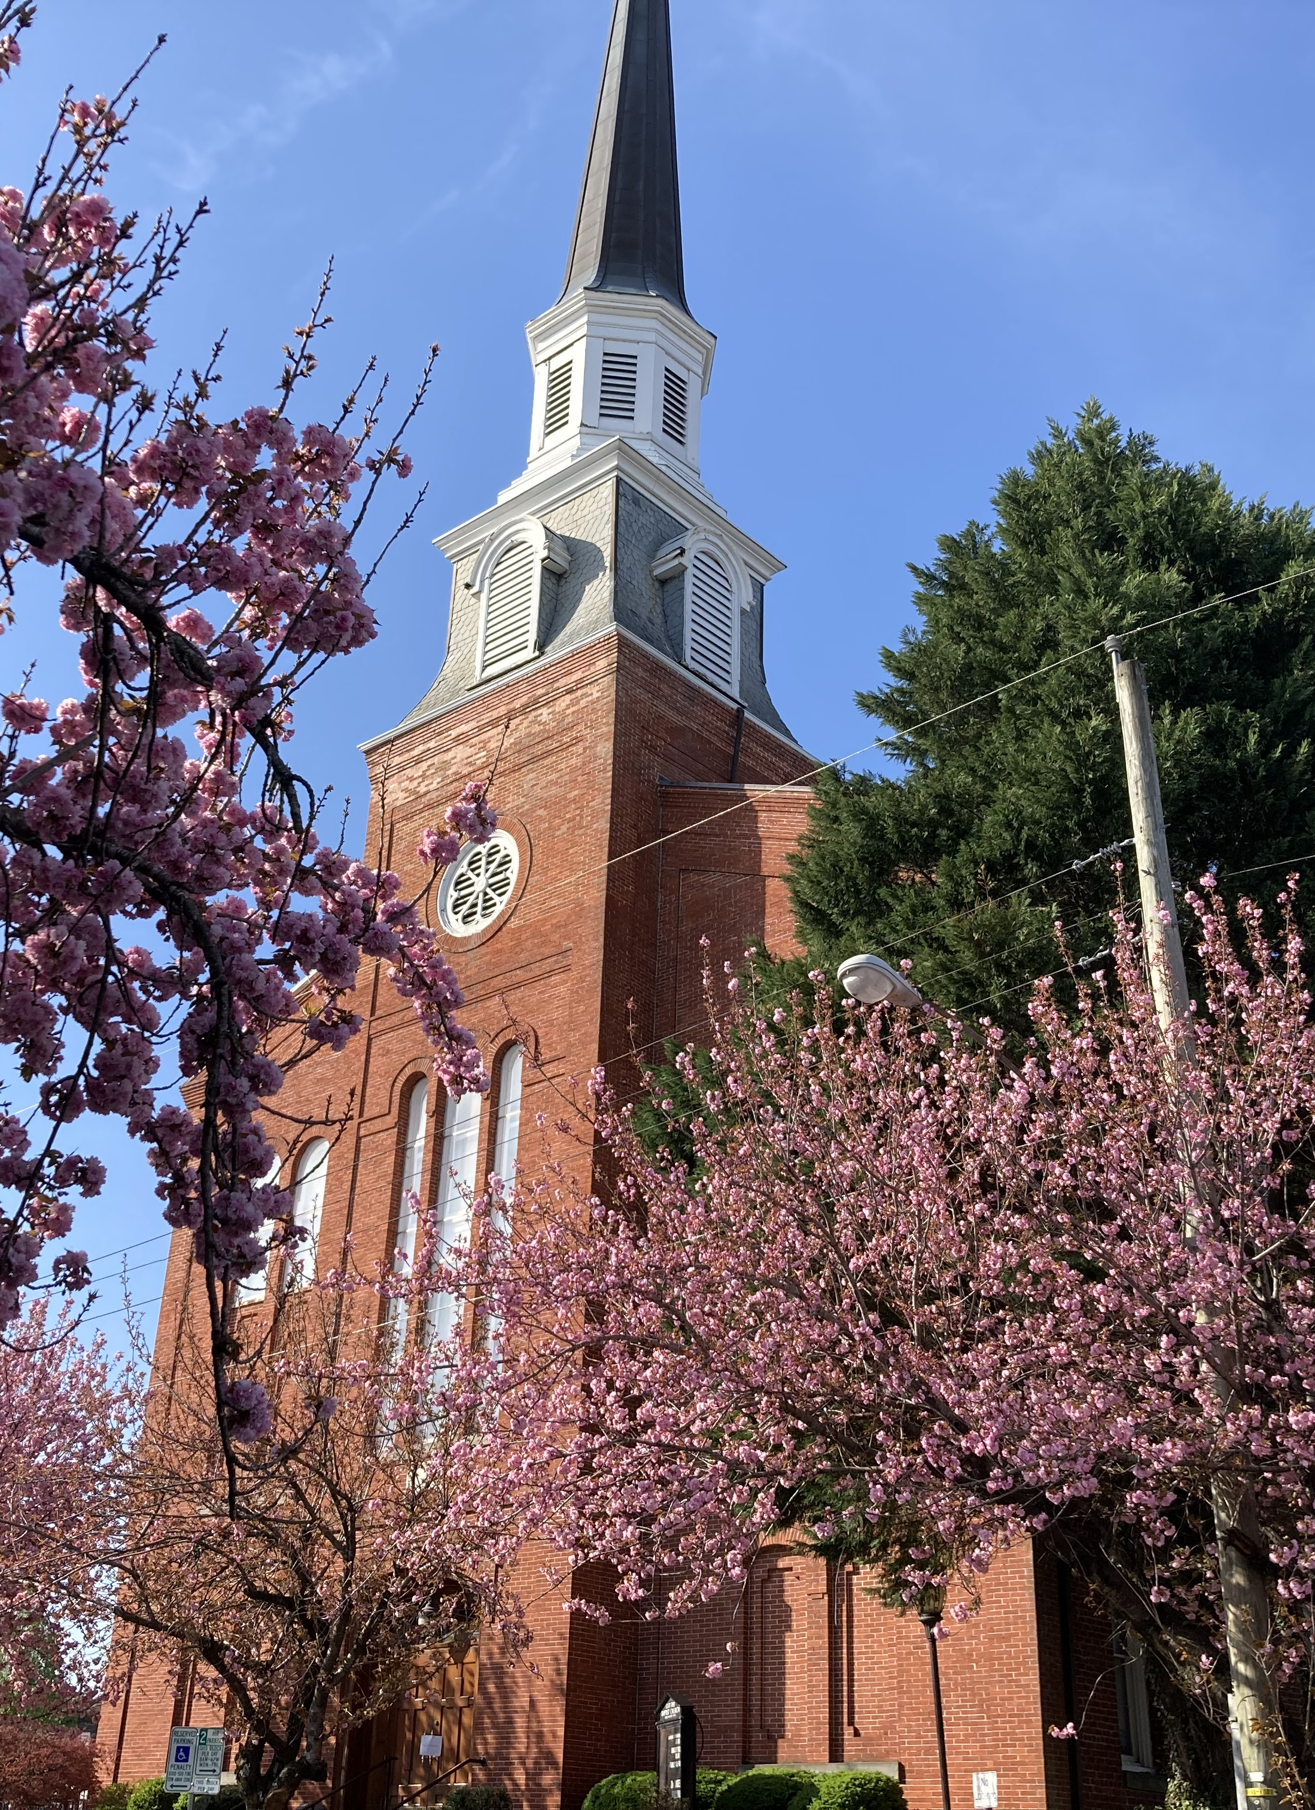
VIRGINIA GROWTH & OPPORTUNITY BOARD
Business Meeting
June 9, 2026

Slide 2
Agenda
OPENING
CONSENT AGENDA
DEPUTY DIRECTOR’S REPORT
EXECUTIVE COMMITTEE
GOVERNANCE AND POLICY COMMITTEE REPORT
PROGRAM PERFORMANCE AND EVALUATION COMMITTEE REPORT
ADJOURNMENT

Slide 3
I. Opening
a. Call to Order
b. Introduction of New Members
c. Roll Call
d. Public Comment

Slide 4
II. Consent Agenda – Action Item
a. March 24, 2026 Meeting Minutes
b. FY27 Regional Per Capital and Competitive Allocations
c. FY27 Regional Capacity Building Allocation and Continuation of Match Waiver
d. FY27 Regional Capacity Building Budget Approvals
e. Amendment Board Policy #7 – FY19 Capacity Building Match Requirement

Slide 5
II.b. FY27 Regional Per Capita Allocations
FY27 PER CAPITA ALLOCATION SCENARIO:
Region | FY26 Per Capita Allocation with $1M Floor | FY27 Per Capita Formula Allocation | Recommended FY27 Per Capita Allocation with $1M Floor
1 | $1,000,000 | $689,875 | $1,000,000
2 | $1,506,951 | $1,500,923 | $1,500,923
3 | $1,000,000 | $689,357 | $1,000,000
4 | $2,608,599 | $2,638,688 | $2,638,688
5 | $3,384,637 | $3,363,752 | $3,363,752
6 | $1,061,688 | $1,064,737 | $1,064,737
7 | $4,970,139 | $4,970,252 | $4,970,252
8 | $1,089,137 | $1,092,242 | $1,092,242
9 | $1,000,000 | $890,174 | $1,000,000
Total | $17,621,151 | $16,900,000 | $17,630,594

Slide 6
III. Deputy Director’s Report
Per Capita Implementation Applications (6) – Action Item
i. Cluster Scale Up (2)
ii. Sites and Infrastructure (1)
iii. Talent Development (3)

Slide 7
Regions 4 and 5: Strategic Cluster Advancement for Leading Energy (SCALE)
Workgroup Reccomendation:
GOVA Request:
Target Cluster(s): Energy
Applicant: Dominion Energy Innovation Center (DEIC)
Investment Strategy: Cluster Scale-Up
Goal: To expand the energy cluster in Regions 4 and 5 by focusing on the grid technologies and advanced power systems sectors.
Products:
Creation of 2 Soft Landing Sites
Formation of Energy Growth Council
In-Depth Market Study and Strategic Plan
Outcomes:
45 Jobs Created
2 Businesses Expanded
2 Businesses Attracted
90 Businesses Served
$651,076
Approval of the application at a reduced award amount of $154,391
Total Match:
$327,128
Participating Localities:
Local Match:
$217,520
Hanover County (Cash and In-Kind)
Town of Ashland (Cash and In-Kind)
Virginia’s Gateway Region, on behalf of its member localities (In-Kind)
Hampton Roads Alliance, on behalf of its member localities (Cash and In-Kind)
Additional Leverage:
$52,750
Total Budget:
$1,030,754

Slide 8
Region 7: National Innovation Quarter (NIQ)
Workgroup Reccomendation:
Target Cluster(s): Cybersecurity, Emerging Technologies
Applicant: Arlington Economic Development (AED)
Investment Strategy: Cluster Scale-Up
Goal: To establish and operationalize a regional innovation district that strengthens Northern Virginia’s dual-use technology ecosystem by accelerating startup formation, workforce retention, talent development and commercialization outcomes.
Products:
Implementation of National Security Capstone Initiative
Establishment and operationalization of the NIQ 501(c)(6) entity
Implementation of dual-use business accelerator programs
Creation of Innovation Lab
Outcomes:
350 Jobs Created
115 Businesses Expanded
32 Businesses Attracted
257 Businesses Served
$100M in follow-on funding raised
GOVA Request:
$3,933,000
Approve
Total Match:
$1,966,783
Participating Localities:
Local Match:
$964,783
Arlington County (Cash and In-Kind)
City of Alexandria (Cash)
Additional Leverage:
$225,000
80 people trained
Total Budget:
$6,124,783

Slide 9
Region 1: Glade Highlands Regional Industrial Park Lots 6 & 7
Workgroup Reccomendation:
Target Cluster(s): Advanced Manufacturing, Agriculture/Food and Beverage Manufacturing, Transportation and Logistics
Applicant: Washington County IDA
Investment Strategy: Site Development and Infrastructure
Goal: To expand the inventory of shovel-ready industrial sites in GO Virginia Region 1.
Outcomes:
10 acres advanced to a higher tier per Virginia Business Ready Sites Program (VBRSP)
260 linear feet of sewer infrastructure
140 feet of water infrastructure
GOVA Request:
$61,409
Approval contingent on successful awards by the U.S. EDA
Total Match:
$54,820
Participating Localities:
Local Match:
$54,820
Washington County (Cash)
Smyth County (Advisory)
Additional Leverage:
$2,209,280
Total Budget:
$2,325,509

Slide 10
Region 2: Sweet Briar Thermal Engineering Program in Greater Lynchburg
Workgroup Reccomendation:
GOVA Request:
Target Cluster(s): IT, Engineering Services, and Emerging Technology
Applicant: Sweet Briar College
Investment Strategy: Talent Development
Goal: To expand the pool of qualified engineers trained in thermal systems prepared to work in the energy sector with Region 2.
Outcomes:
15 people trained
3 job placements
7 interns placed
$139,777
Defer
Total Match:
$71,530
Participating Localities:
Local Match:
$23,000
Amherst County (Cash)
Campbell County (Cash and In-Kind)
Town of Amherst (Cash)
Additional Leverage:
$ -
Total Budget:
$211,307

Slide 11
Region 4: Cybersecurity and Artificial Intelligence Lab to Advance Workforce Readiness
Workgroup Reccomendation:
GOVA Request:
Target Cluster(s): Information Technology
Applicant: Brightpoint Community College
Investment Strategy: Talent Development
Goal: To expand the pool of qualified workers in Cybersecurity and Artificial
Intelligence by integrating hands-on instruction, industry-recognized credentialing, and
employer-driven work-based learning.
Products:
Creation of AI and Cybersecurity Lab
Outcomes:
100 People Trained
50 Job Placements
10 New Interns Placed
50 Credentials Awarded
$351,537
Approve
Total Match:
$190,617
Participating Localities:
Local Match:
$40,617
Charles City County (Cash)
Chesterfield County (Cash)
Dinwiddie County (Cash)
Prince George County (Cash)
Surry County (Cash)
Sussex County (Cash)
City of Colonial Heights (Cash)
City of Hopewell (Cash)
City of Petersburg (Cash)
Additional Leverage:
$8,829
Total Budget:
$550,983

Slide 12
Region 8: Shenandoah Valley Aviation and Logistics Workforce Pipeline
Workgroup Reccomendation:
GOVA Request:
Target Cluster(s): Transportation and Logistics
Applicant: Winchester Regional Airport Authority
Investment Strategy: Talent Development
Goal: To expand the pool of qualified applicants in GO Virginia Region 8’s Transportation and Logistics industry sectors.
Outcomes:
303 People Trained
45 Job Placements
15 Businesses Served
89 New Interns Placed
27 New Apprenticeships Created
5 New Programs Implemented
205 Credentials Awarded
97 Students Completing Dual Enrollment Programs
$475,000
Approve
Total Match:
$237,500
Participating Localities:
Local Match:
$47,500
Frederick County (Cash)
City of Winchester (Cash)
Winchester Regional Airport Authority, on behalf of its member localities (Cash)
Additional Leverage:
$ -
Total Budget:
$712,500

Slide 13
III. Deputy Director’s Report
b. Competitive Applications (4) – Action Item
i. Cluster Scale Up (1)
ii. Sites and Infrastructure (1)
iii. Talent Development (1)
iv. Entrepreneurship and Innovation (1)

Slide 14
Region 9: Venture Central Food and Beverage Business Accelerator
Workgroup Reccomendation:
Target Cluster(s): Food and Beverage Manufacturing
Applicant: Venture Central
Investment Strategy: Cluster Scale Up
Goal: To expand the food and beverage manufacturing sector in Region 9 through
assisting small manufacturers.
Outcomes:
10 Jobs Created
16 Businesses Expanded
36 Businesses Served
$150,000 Raised by Businesses Served
GOVA Request:
$262,192
Approve
Total Match:
$131,308
Participating Localities:
Local Match:
$120,000
Albemarle County (Cash)
Fauquier County (Cash)
Madison County (Cash)
Nelson County (Cash)
Orange County (Cash)
City of Charlottesville (Cash)
Additional Leverage:
$23,000
Total Budget:
$416,500

Slide 15
Regions 7, 4, & 5: AED Commercial Real Estate
Workgroup Reccomendation:
Target Cluster(s): Pharmaceutical Manufacturing, Information Technology, Cybersecurity, Data Analytics, and Modeling and Simulation, Ship Repair and Shipbuilding, Unmanned Systems, Computer Services, and Life Sciences.
Applicant: Arlington Economic Development (AED)
Investment Strategy: Site Development and Infrastructure
Goal: To increase the number of business-ready sites within urban markets and support local and state decision-making by providing clear, actionable insights into office real estate conditions affecting key priority industries identified by the participating GO Virginia
regions.
Products:
Economic office market demand analysis and forecasting report
Gap analysis and public sector opportunity assessment
Conceptual redevelopment program design(s)
GOVA Request:
$535,000
Approval at the $250,000 planning grant limit defined in the FY26
Competitive Fund guidelines.
Total Match:
$268,069
Participating Localities:
Local Match:
$202,996
Arlington County (Cash and In-Kind)
Fairfax County (Cash)
Henrico County (Cash and In-Kind)
City of Alexandria (Cash and In-Kind)
City of Norfolk (Cash)
City of Richmond (Cash and In-Kind)
City of Virginia Beach (Cash and In-Kind)
Additional Leverage:
$ -
Total Budget:
$803,069

Slide 16
Region 2: GO TEC Career Connections Expansion in Regions 2 & 3
Workgroup Reccomendation:
GOVA Request:
Target Cluster(s): Advanced Materials Manufacturing; Manufacturing for Transportation, Energy & Autonomy; Life Sciences & Biotechnology; and IT, Engineering Services & Emerging Technology
Applicant: New River Valley Regional Commission
Investment Strategy: Talent Development
Goal: To expand the Great Opportunities in Technology and Engineering Careers (GO TEC) program in five school divisions within Region 2 and one additional school division in Region 3.
Products:
Creation of 11 middle school Career Connection labs.
Outcomes:
4,300 People Trained
1 New Program Implemented
$2,295,384
Defer
Total Match:
$1,377,022
Participating Localities:
Local Match:
$1,313,022
Amelia County (In-Kind)
Amherst County (In-Kind)
Floyd County (In-Kind)
Giles County (In-Kind)
Montgomery County (In-Kind)
Roanoke County (In-Kind)
Additional Leverage:
$ -
Total Budget:
$3,672,406

Slide 17
Region 8: Shenandoah Valley Innovation Commercialization Impact Network (SVICIN)
Workgroup Reccomendation:
GOVA Request:
Target Cluster(s): Agriculture, Advanced Manufacturing, Life Sciences
Applicant: James Madison University
Investment Strategy: Entrepreneurship and Innovation
Goal: To increase the number of successful small business start-ups in GO Virginia Region 8.
Products:
Region-wide tech transfer office established
Tailored business accelerator program
Outcomes:
12 Jobs Created
2 Businesses Expanded
4 Businesses Created
6 Businesses Served
$500,0000 Raised by Businesses Served
2 New Products Released to Production
3 Patents Filed
1 Patent Awarded
$879,633
Defer
Total Match:
$439,964
Participating Localities:
Local Match:
$19,740
City of Harrisonburg (Cash)
City of Staunton (Cash)
City of Waynesboro (Cash)
Additional Leverage:
80 people trained
$248,180
Total Budget:
$1,567,777

Slide 18
IV. Executive Committee Report

Slide 19
V. Governance and Policy Committee Report

Slide 20
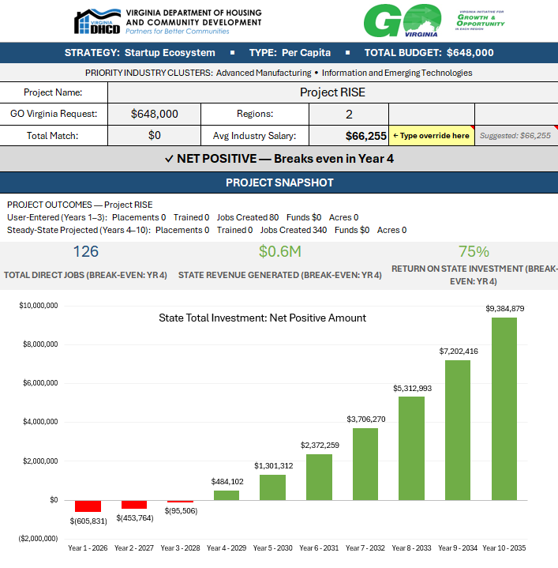
VI. Program Performance and Evaluation Committee Report – Action Item
a. JLARC Recommendation #12 – Return on Investment (ROI)

Slide 21
VII. Adjournment

