Slide 1
ECB approvals

Slide 2
Administratively approved projects under $100,000
ECB approvals
4 PROJECTS APPROVED

Slide 3
Enhanced Capacity Building
4 proposals administratively approved
  3 out of 9 regions participated
  Total Request: $ 364,111
  Total Match: $605,643
ECB approvals

Slide 4
Region 2
Enhanced Capacity Building
Ignite Internship Program Expansion
Ignite Internships
  United Way of Southwest Virginia (UWSWVA)
  Total Request: $99,406
  Total Match: $102,886

Slide 5
Application overview
Region 2 submitted on behalf of UWSWVA
Request of $99,406 for personnel
To expand Ignite Internship program into Giles and Pulaski counties and the City of Radford
Builds off previously funded Region 1 per capita project ($250,000) that created 1)a web-based platform to deliver post-secondary education awareness and streamlined workforce credentialing, 2) work-based learning opportunities, and 3) local employment matching for graduates
Ignite Internships

Slide 6
Recommendation
DHCD staff has administratively approved this application
Ignite Internships
Eligibility Requirements
$1:1 Match | ✓
Local Participation | ✓
Alignment with G&D Plan | ✓
Alignment with GOVA Strategies | ✓
High-Wage Job Creation Potential | ✓
Grant Management Capacity | ✓
Line of Sight to Future GOVA Project | ✓

Slide 7
Region 4
Enhanced Capacity Building
Virginia’s Growth Region Site Readiness
VGR site readiness
  Virginia’s Growth Region (VGR)
  Total Request: $100,000
  Total Match: $119,757

Slide 8
Application overview
Region 4 submitted on behalf of Virginia’s Growth Region
Request of $100,000 for contract services
VGR will work with an engineering firm to characterize 89 sites according to the VBRSP and to develop plan for advancing sites to Tier 4
Dinwiddie, Prince George, Sussex, Surry counties and the cities of Colonial Heights, Hopewell and Petersburg are participating
VGR site readiness

Slide 9
Recommendation
DHCD staff has administratively approved this application
VGR Site readiness
Eligibility Requirements
$1:1 Match | ✓
Local Participation Requirement | ✓
Alignment with GOVA Strategies | ✓
Alignment with G&D Plan | ✓
High-Wage Job Creation Potential | ✓
Grant Management Capacity | ✓
Line of Sight to Future GOVA Project | ✓

Slide 10
Region 5
Enhanced Capacity Building
Hampton Roads Coalition for Talent Development
  Hampton Roads Workforce Council
  Total Request: $99,705
  Total Match: $318,000

Slide 11
Application overview
Region 5 submitted on behalf of Hampton Roads Workforce Council
Request of $99,705 for personnel and operations
To create systematic collaboration, involvement and investment of major partners in the area in talent development
The Council will create new senior-level position to establish implementation and communication plans and to convene business leaders and regional workforce providers from 14 of the 16 localities in Region 5 to identify and address regional needs
HR Coalition for talent development

Slide 12
Recommendation
DHCD staff has administratively approved this application
HR Coalition for talent development
Eligibility Requirements
$1:1 Match | ✓
Local Participation Requirement | ✓
Alignment with GOVA Strategies | ✓
Alignment with G&D Plan | ✓
High-Wage Job Creation Potential | ✓
Grant Management Capacity | ✓
Line of Sight to Future GOVA Project | ✓

Slide 13
Region 5
Enhanced Capacity Building
Accomack-Northampton Sewer and Sites Study
  Accomack-Northampton Planning District Commission Total Request: $65,000
  Total Match: $65,000

Slide 14
Application overview
Region 5 submitted on behalf of Accomack-Northampton Planning District Council (ANPDC)
Request of $65,000 for contract services and project oversight
To complete 1) the Eastern Shore Main Force Sewer Transmission Line study and 2) evaluate 25+ acre sites within the ANPDC footprint
The sewer line study, assisted by the Hampton Roads Sanitation District (HRSD), will help the Eastern Shore increase its sewer capacity and enable it to meet the minimum infrastructure requirements to become eligible for the Virginia Business Ready Site Program (VBRSP)
Region 5 Sewer and sites studies

Slide 15
Recommendation
DHCD staff has administratively approved this application
Region 5 sewer and sites studies
Eligibility Requirements
$1:1 Match | ✓
Local Participation Requirement | ✓
Alignment with GOVA Strategies | ✓
Alignment with G&D Plan | ✓
High-Wage Job Creation Potential | ✓
Grant Management Capacity | ✓
Line of Sight to Future GOVA Project | ✓

Slide 16
PER CAPITA APPS

Slide 17
Per Capita Funding
6 proposals submitted
  6 out of 9 regions participated
  3 Entrepreneurship & 3 Talent Development
  Total Request: $1,825,572
  Total Match: $2,300,500
  Includes $ 584,300 Local Match
PER CAPITA APPS

Slide 18
REGION 2
IMPLEMENTATION
Increasing Birth Rates of New High Growth Companies for Region 2
  The Advancement Foundation (TAF)
  Total Request: $150,000
  Total Match: $315,000 including $193,800 local match

Slide 19
Application overview
Region 2 submitted on behalf of the Advancement Foundation (TAF)
Request of $150,000 for a new program designed to increase the number of high growth companies by aligning regional assets, accelerating proof of concept, offering comprehensive technical support and growing a culture of innovation by actively engaging industry experts, STEM practitioners, and student investors
GO Virginia funds will be used for personnel, operations, and outreach
Region 2 innovation mill

Slide 20
Workgroup feedback
Significant local support and partnerships
Aligns with target industries of information and emerging technologies, advanced manufacturing, food and beverage manufacturing, and health sciences
Assumptions seem aggressive given velocity in the region
What is TAF track-record of working with high-growth startups?
Could serve as a feeder for previously-funded RAMP Accelerator
Region 2 innovation mill

Slide 21
Recommendation
DHCD recommends this application for approval
Eligibility Requirements
$1:1 Match | ✓
Local Match | ✓
Local Participation Requirement | ✓
Out-of-State Revenue | ✓
High-Wage Job Creation Potential | ✓
3 Year ROI | ✓
Alignment with G&D Plan | ✓
Grant Management Capacity | ✓
Sustainable after GOVA Funds | MAYBE
Region 2 innovation mill

Slide 22
REGION 5
IMPLEMENTATION
757 Angel Network
  757 Angel Network
  Total Request: $240,000
  Total Match: $479,000, including $60,000 local match

Slide 23
Application overview
Region 5 submitted on behalf of 757 Angel Network
Request of $240,000 to fund personnel, operations, outreach and travel
To sustain and expand efforts to connect most promising startup and early stage companies to smart growth capital
757 Angels is the first centralized source of angel and seed stage capital in Hampton Roads, with 120 members and $40M deployed in Virginia companies to date
757 angel network

Slide 24
Workgroup feedback
Strong track record since inception in 2015
Aligns with the TEConomy recommendations
Supports growth in targeted clusters such as unmanned systems, water technologies, and cybersecurity
Local match includes 100% cash
The hiring of a new Program Director to support the Executive Director will enable the 757 Angels to design and implement the corporate sponsorship strategy, attract new members, and retain existing members to sustain the program long-term
757 angel network

Slide 25
Recommendation
DHCD recommends this application for approval
Eligibility Requirements
$1:1 Match | ✓
Local Match | ✓
Local Participation Requirement | ✓
Out-of-State Revenue | ✓
High-Wage Job Creation Potential | ✓
3 Year ROI | ✓
Alignment with G&D Plan | ✓
Grant Management Capacity | ✓
Sustainable after GOVA Funds | ✓
757 angel network

Slide 26
REGION 9
IMPLEMENTATION
Catalyst Accelerator Program
  University of Virginia Darden School of Business
  Batten Institute for Entrepreneurship and Innovation
  Total Request: $475,200
  Total Match: $476,000, including $110,000 local match

Slide 27
Application overview
Region 9 submitted on behalf of UVA Darden School and Institute for Entrepreneurship and Innovation
Request of $475,200 for programming, internships, personnel, office space, and travel
The Catalyst will offer a portfolio of programming and network events, as well as internship and project-based learning opportunities for UVA students
Fills an existing gap in the local ecosystem by providing the dedicated staff, workspace, programming, mentorship, and grant funding to support up to 20 high-potential companies
Catalyst accelerator

Slide 28
Workgroup feedback
Addresses an identified gap in the regional entrepreneurial ecosystem and aligns with the TEConomy recommendations
Innovation is a priority in the growth and diversification plan
Supports growth in targeted sectors such as biotechnology and IT
Significant return on investment (ROI) potential
Long-term sustainability through Batten Institute (non-state funds)
Workforce development through internships and connections to UVA alumni
Intensive programming ensures higher success rate for completers
Darden iLab has a robust track record of creating and retaining startups in Virginia
Catalyst accelerator

Slide 29
Recommendation
DHCD recommends this application for approval
Eligibility Requirements
$1:1 Match | ✓
Local Match | ✓
Local Participation Requirement | ✓
Out-of-State Revenue | ✓
High-Wage Job Creation Potential | ✓
3 Year ROI | ✓
Alignment with G&D Plan | ✓
Grant Management Capacity | ✓
Sustainable after GOVA Funds | ✓
Catalyst accelerator

Slide 30
REGION 1
IMPLEMENTATION
Smart Farming at the Center for Workforce and Innovation of Appalachia
  Mountain Empire Community College (MECC)
  Total Request: $310,372
  Total Match: $380,500, including $62,500 local match

Slide 31
Application overview
Region 1 submitted on behalf of MECC
Request of $310,372 for equipment, lab renovations, and utilities
To expand the unmanned systems coursework with two new capstone courses on smart farming and the use of technology to improve farming techniques, increase yields, and maximize agricultural profits
MECC will offer students hands-on drone training and the ability to earn national credentials for FAA drone operations, agricultural inspections, and pesticide spraying
Smart farming

Slide 32
Workgroup feedback
Aligns with targeted clusters of agriculture and information technology
Diversifies training and employment opportunities for former coal industry workers
Allows MECC to reallocate existing ARC workforce funding
Modest but obtainable return on investment (ROI)
VCCS has already approved these new courses
Skills acquired will transfer to jobs in data analytics, water technologies, mine and quarry operations, among others
Smart farming

Slide 33
Recommendation
DHCD recommends this application for approval
Eligibility Requirements
$1:1 Match | ✓
Local Match | ✓
Local Participation Requirement | ✓
Out-of-State Revenue | ✓
High-Wage Job Creation Potential | ✓
3 Year ROI | ✓
Alignment with G&D Plan | ✓
Grant Management Capacity | ✓
Sustainable after GOVA Funds | ✓
Smart farming

Slide 34
REGION 6
IMPLEMENTATION
Cybersecurity Certification Program
  University of Mary Washington (UMW)
  Total Request: $110,000
  Total Match: $110,000, including $50,000 local match

Slide 35
Application overview
Region 6 submitted on behalf of UMW
Request of $110,000 for personnel, rent, curriculum, and program operations
To establish a cybersecurity preparatory program to train Certified Information Systems Security Professionals (CISSP)
By contributing to the critical mass of certified cyber professionals, UMW will help businesses in the region fill current openings that are difficult to fill due to the inadequate supply of certified professionals
Cybersecurity certification program

Slide 36
Workgroup feedback
Addresses an identified workforce gap in the region and statewide
Aligns with targeted clusters of information technology and professional services
Significant return on investment (ROI) potential - Credentials earning $90,000
New partnerships with regional higher education institutions
Central location allows UMW to serve several regions
Demonstrated demand for credentials from regional businesses
70 jobs – includes upskilled workers
Unallowable use of WIOA matching funds (approximately $32,000) – will need to identify another funding source
Cybersecurity certification program

Slide 37
Recommendation
DHCD staff recommend this application for approval CONTINGENT upon the applicant replacing ineligible match funding with another source of eligible match
Cybersecurity certification program
Eligibility Requirements
$1:1 Match | ✓
Local Match | ✓
Local Participation Requirement | ✓
Out-of-State Revenue | ✓
High-Wage Job Creation Potential | ✓
3 Year ROI | ✓
Alignment with G&D Plan | ✓
Grant Management Capacity | ✓
Sustainable after GOVA Funds | ✓

Slide 38
REGION 8
IMPLEMENTATION
Shihadeh Innovation Center for Career and Technical Education
  Winchester Public Schools
  Total Request: $540,000
  Total Match: $540,000, including $108,000 local match

Slide 39
Application overview
Region 8 submitted on behalf of Winchester Public Schools
Request of $540,000 for equipment and installation costs
To renovate the former John Kerr Elementary School in partnership with Lord Fairfax Community College (LFCC)
Curriculum at the new facility will be offered through a Professional Skills Academy, a Health Sciences Academy, and an Information Technology Academy
These academies will be supported by an expanded Work-Based Learning (WBL) program to connect students to regional businesses filling high-wage jobs in the targeted clusters
Shihadeh innovation center

Slide 40
Workgroup feedback
Strong local and private support for the project
Project procurement process will move forward with Construction Manager At Risk approach – successful model used with Loudoun and Frederick County Public Schools
Project still on track to begin renovations in September 2019
Addresses workforce gap in target industries of advanced manufacturing and IT
Diversifies employment opportunities for students directly entering workforce
Pipeline of demand demonstrated through private industry support and partners such as Perry Engineering, Barrett Machine, Fabritek Company, Tech Team Solutions, Winchester Metals, Pillar Enterprise, and Valley Health – 70 Internships from 15 Companies
Significantly overleveraged with private and local funding
Outcomes during project period, with expanding impact in later phases
Shihadeh innovation center

Slide 41
Recommendation
DHCD recommends this application for approval
Eligibility Requirements
$1:1 Match | ✓
Local Match | ✓
Local Participation Requirement | ✓
Out-of-State Revenue | ✓
High-Wage Job Creation Potential | ✓
3 Year ROI | ✓
Alignment with G&D Plan | ✓
Grant Management Capacity | ✓
Sustainable after GOVA Funds | ✓
Shihadeh innovation center

Slide 42
Competitive app

Slide 43
Competitive Funding
1 proposal submitted
  2 out of 9 regions participated
    Workforce
  Total Request: $4,896,528
  Total Match: $4,915,962
  Includes $2,945,981 Local Match
Competitive app

Slide 44
REGION 3 & 1
IMPLEMENTATION
Great Opportunities in Technology and Engineering Course (GO-TEC) Phase 2
  Danville Community College (DCC)
  Total Request: $4,896,528
  Total Match: $4,915,962, including $2,945,981 local match

Slide 45
Application overview
Regions 3 & 1 submitted on behalf of DCC
Request of $4,896,528 for personnel, instructor training, program outreach, equipment, build-out of 14 middle-school career connection labs, program materials
Working with regional school and higher-education partners to build a regional training system of scale for careers in IT and focused areas of advanced manufacturing
To build a pipeline of talent beginning with middle school students, in order to increase the number of students entering the five regional training areas of need: precision machining, welding, IT/cybersecurity, robotics/mechatronics/automation, and advanced materials
Gotec phase 2

Slide 46
Workgroup feedback
Replicable across regions
Significant local support and match from across the region
Diversifies employment opportunities for students directly entering workforce
Need more time to validate outcomes from Phase 1 before such a large scale-up
Gotec phase 2

Slide 47
Scaled Project update
  Request of $1,320,787 for personnel, instructor training, program outreach, equipment, build-out of 4 middle-school career connection labs, program materials
Gotec phase 2
Eligibility Requirements
$1:1 Match | ✓
Local Match | ✓
Local Participation Requirement | ✓
Out-of-State Revenue | ✓
High-Wage Job Creation Potential | MAYBE
3 Year ROI | ✓
Alignment with G&D Plan | ✓
Grant Management Capacity | ✓
Sustainable after GOVA Funds | MAYBE

Slide 48
Recommendation
DHCD recommends approval of the 12 month funding request of Phase 2 for $1,320,787
DHCD also recommends the Board reserve the full $4,896,528 and require the applicant to demonstrate project results and validation of this model to DHCD and the Board before contract negotiation is allowed to proceed on the remaining $3,575,741 of the requested grant
Gotec phase 2

Slide 49
FY20 ALLOCATIONS

Slide 50
FY20 CAPACITY BUILDING
DHCD recommends that the Board move to waive the requirement for $1:1 matching funds for the $2,250,000 allocated ($250,000 per region) for FY ’20 capacity building funds
REGION | FY20 CB ALLOCATIONS
1 | $250,000
2 | $250,000
3 | $250,000
4 | $250,000
5 | $250,000
6 | $250,000
7 | $250,000
8 | $250,000
9 | $250,000
Total | $2,250,000
FY20 ALLOCATIONS

Slide 51
FY20 PER CAPITA
DHCD recommends that the Board move to create a floor of $1,000,000 for three regions by reallocating $643,764 from the competitive pool to per capita
REGION | FY19 Per Capita Allocation with $1M Floor | FY20 Per Capita Formula Allocation | Recommended FY20 Per Capita Allocation with $1M Floor
1 | $1,000,000 | $755,564 | $1,000,000
2 | $1,279,626 | $1,550,032 | $1,550,032
3 | $1,000,000 | $742,141 | $1,000,000
4 | $2,047,135 | $2,503,884 | $2,503,884
5 | $2,839,932 | $3,426,243 | $3,426,243
6 | $1,000,000 | $1,008,621 | $1,008,621
7 | $4,088,427 | $4,987,427 | $4,987,427
8 | $1,000,000 | $1,067,557 | $1,067,557
9 | $1,000,000 | $858,531 | $1,000,000
Total | $15,255,120 | $16,900,000 | $17,543,764
FY20 ALLOCATIONS

Slide 52
vbrsp

Slide 53
ENHANCED SITE CHARACTERIZATION PLAN
March 12, 2019

Slide 54
Virginia Business Ready Sites Program overview
Overview from start of program to present
    BRSP (2015) created to Identify and Assess Readiness of Sites
      VEDP: Virginia’s inventory of large, shovel ready sites is low
        Projects lost: Caterpillar and Continental Tire
        VEDP estimates a total of 47 projects, worth more than $6.5 B in capital investment were lost between 2005 and 2014
        Since the last analysis, VEDP is aware of major projects lost due to a lack of prepared sites, such as Toyota-Mazda which was a $1.6 B project with 4,000 manufacturing jobs
    BRSP Working Group Formed (2016):
      Multi-Disciplinary Team
      Developed Program Standards and Guidelines
        Site Characterization
        Site Development
    Initial Funding
      FY 17 - $750,000
      FY 18 - $562,000
    Current Funding
      FY 19 - $3.1 million ($2 million for bulk characterization)
      FY 20 - $1.1 million

Slide 55
VBRSP IS THE PRIMARY PROGRAM TO GATHER INFORMATION VIA CHARACTERIZATIONS AND TO DEVELOP SELECT SITES
  Purpose
  Process
  Assess existing levels of readiness and next steps for development of Virginia’s site portfolio
  Characterization grants of up to $5K* per site are awarded to sites selected from an applicant pool by a private-sector led working group
Characterization grants
  Virginia Business Ready Sites Program
  Fund targeted development efforts to move identified sites to higher tiers of readiness
  Development grants of up to $500K* per site are awarded to sites selected from an applicant pool by a private sector-led working group
Development
grants
*Requires 1:1 match

Slide 56
Overview of Grant Application and Funds
Characterization Grants
Development Grants
  Maximum Grant - $5,000
  1:1 match
  Application – rolling
  Characterization reimbursement
  Grant Amounts:
    Tier 1 to 2 - $100,000
    Tier 2 to 3 - $250,000
    Tier 3 to 4 - $500,000
    Tier 4 to 5 - $500,000
  1:1 match
  Competitive Grant
  Application Deadline – fall of each year

Slide 57
VIRGINIA BUSINESS-READY SITES CHARACTERIZATIONS
TIER DESCRIPTIONS FOR SITE READINESS
Estimated development investments
Tier
Description
1
Raw land with interested seller
Not zoned for economic development, but Comp Plan indicates appropriateness
N/A
2
Site controlled and marketed for development
Option agreement with commitment to a competitive sales price
Cost of option or acquisition
Acquisition: $4-20K per acre*
(from Tier 1 to Tier 2)
Zoned industrial/commercial, due diligence completed
  Wetlands survey with ACOE approval within last 5 years
  Geotechnical borings
  Boundary and topographical survey
  Cultural resources review
  Endangered species review
  Phase I ESA
Quantified estimated costs of development
$1-2K per acre
(from Tier 2 to Tier 3)
“Soft” Costs
3
Soft Costs: All infrastructure permit issues identified and quantified (wetlands, erosion and soil, T&E)
Infrastructure deliverable within 12 months
Hard Costs: Infrastructure in place
$5-25K per acre
(Tier 3 to 4“Soft” Costs)
4
$20-75K per acre
(Tier 3 to 4 “Hard” Costs)
5
“Shovel Ready” – site cleared and rough graded
Most permits in place: erosion and sediment, stormwater mgmt.
Preliminary site plan, ready for site disturbance permit
$50-100K per acre
“Hard” Costs
*Varies by location

Slide 58
The vbrsp has significantly strengthened Virginia’s site development efforts
Characterization Grants
Development Grants
Grants Awarded: 40 to date
Total Funded: $94,700
FY19 Characterization Grants:
Grant funds are still available. Applications are accepted on a rolling basis
Applications Received: 20 (FY18)
Total Funding Requested:
$3.8MM (out of $24MM of capital costs)
Grants Awarded: 8
Total FY18 Funded: ~$1.2MM
FY19 Development Grants
13 grants totaling $3.4 MM are currently under review. Development grant fund is $1MM

Slide 59
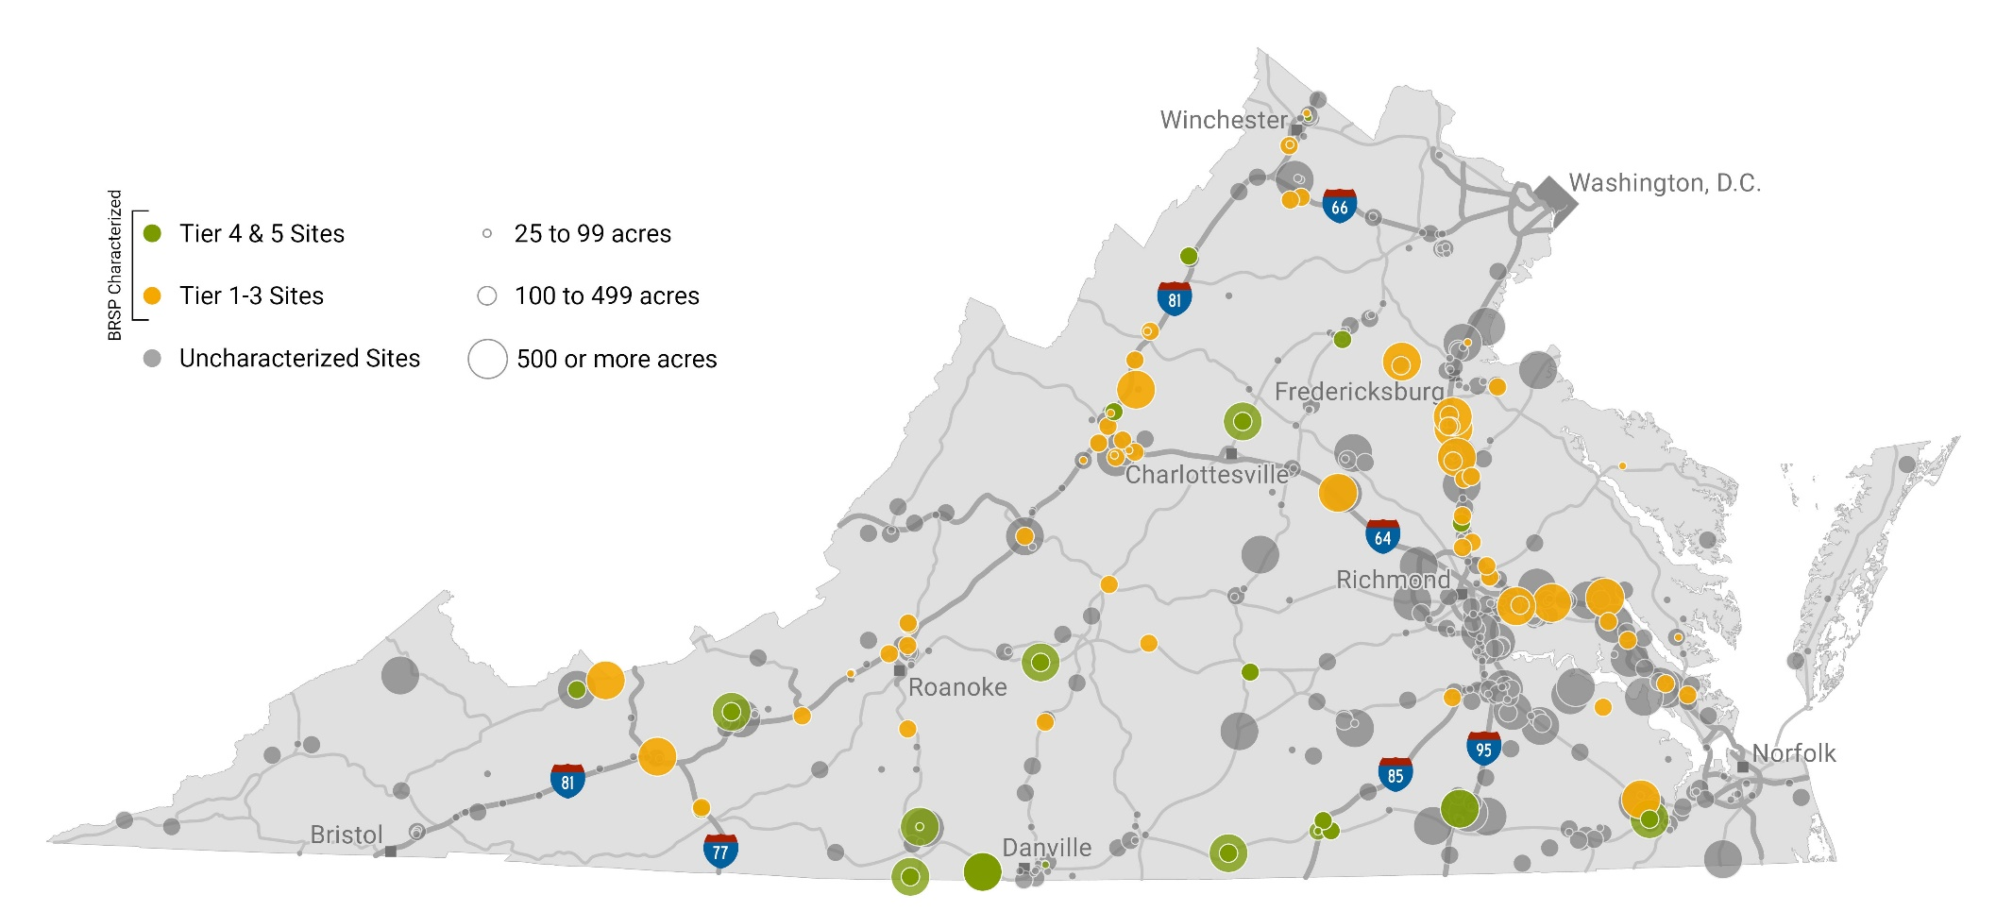
…BUT LESS THAN 20% OF 25+ ACRE SITES IN VASCAN HAVE BEEN CHARACTERIZED
95¹ of 535 sites of 25+ acres have been characterized, approximately half funded by VBRSP characterization grants and the remainder by regional / local efforts
VBRSP has provided characterization grants to 40 sites² to date
Sites characterized as tier 4 and 5 are considered certified or “project-ready” (43 sites)
1. Numerous additional sites have been characterized by engineering firms but are not 25+ acres and in VAScan database
2. VBRSP grants can be applied to an entire site, a subset(s) of one “parent” site, or multiple sites (i.e., two sites within one industrial park)

Slide 60
VEDP HAS BEEN PURSUING A COMPREHENSIVE STRATEGY TO ANALYZE AND DEVELOP VIRGINIA’S SITES PORTFOLIO
1
2
3
4
5
How many project-ready sites do we have in Virginia?
How many sites do we need to achieve our job growth goals?
What is the gap between what we have and what we need?
How much will it cost to close the gap?
How will we fund it?

Slide 61
VEDP WILL UTILIZE A PORTION OF NEW FUNDING TO ESTIMATE AND PRIORITIZE SITE DEVELOPMENT INVESTMENTS
4
How much will it cost to close the gap?
Characterize all 25+ acre sites in VA Scan
Evaluate economic development potential of sites
Prioritize sites for investment
Contract with site engineers to estimate tier levels and development costs
Assign a grade to each site
Advisory committee recommends priorities
Envision VEDP serving as the client to cover hundreds of sites quickly and secure attractive pricing
VEDP would likely not require a match from localities to expedite the process

Slide 62
proposed PROCESS TIMELINE
MARCH
APRIL
MAY
JUNE
JULY
AUGUST
EVENT
Review Characterization Strategy with Board
Release RFP/ Advise Localities to Gather Data
Review Proposals / Award Contracts
Characterize Sites
Review VEDP site model with consultants
Engineers Propose Grading Matrix
Review Grading Matrix with Advisory Committee
Review work-in-progress with Engineers
Engineers Submit Assessments to Committee
Review Site Assessments with Committee
VEDP Board
VEDP Staff
Engineers
Statewide Advisory Committee

Slide 63
STATEWIDE SITES ADVISORY GROUP WILL REVIEW SITE ASSESSMENTS AND RECOMMEND INVESTMENT PRIORITIES
  The statewide advisory group will consist of representatives from the following categories:
    GO Virginia
    Local and Regional Economic Developers
    Utilities (Dominion, AEP, VNG, Columbia)
    Telecommunications Representatives (VCTA)
    State Agencies (DHCD, TRRC VDOT, VDEQ)
    Private Business Leaders
    Commercial Real Estate Developers
    Site Consultants
    Workforce Experts

Slide 64
ENHANCED INSIGHTS WILL HAVE SIGNIFICANT BENEFITS FOR ALL ECONOMIC DEVELOPMENT STAKEHOLDERS
Encourage regional collaboration on high-potential sites
+
Support applications for GOVA funding
+
Support localities’ efforts to prioritize their investments
+
Promote public-private partnerships for site development
+
Facilitate evaluation of utility infrastructure investments under HB1840 and SB1695/HB2738
+
Provide GA insight into strategic and targeted investments for site development
+

Slide 65
Questions/Thoughts?
Christy Morton
John Loftus
David Devan
Vice President of External Affairs
Sites and Buildings Manager
Economic Competitiveness
804.545.5613
804.545.5786
804.545.5762
cmorton@vedp.org
jloftus@vedp.org
jloftus@vedp.org

Slide 66

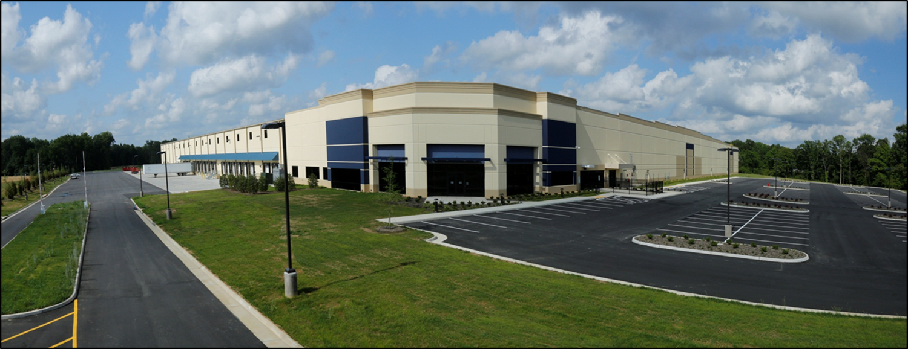

GO Virginia Board
Is Virginia Site Ready?
March 12, 2019
By: Joseph C Hines, PE, MBA – Principal & Director of Economic Development
Timmons Group Infrastructure & Economic Development Practice
Notes:
Thank you Brent for that nice introduction. As I heard you reading my bio, I was thinking to myself, wow do I know that guy? It is indeed an honor to be here with you today as we talk about “Getting the Product Ready for Market” or as I like to call it, getting “Prospect Ready”.
I would like to commend VEDP for the job they are doing as I know you have a difficult task. Try to land a prospect when you have 134 cities and Counties to work with and 191 incorporated towns, of which only 25 of the towns have a population greater than 5,000 people. You all have been a great partner and resource for a number of our clients and we appreciate the opportunity to work with you all on this webinar.
As Brent mentioned, I’m a registered Professional Engineer, and I also have an MBA. I’ve often said I’ve felt a business person first, who just so happens to have an engineering license. My background helps give me an interesting perspective on this subject as we at Timmons Group try to marry up what is going on in the industry with what our clients are putting on the ground.

Slide 67

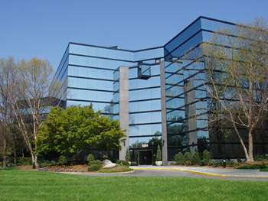




About Timmons Group
Virginia based Consultant Engineering Firm
Chesterfield Headquarters w/ 7 Virginia offices
Employ 390+ Virginians (67% of all employees)
Engineering News Record’s Top 500 Design Firms for 26+ years
Extensive experience with economic development, master planning, site & infrastructure development and GIS site selection
Notes:
298 employees in RVA and PG

Slide 68

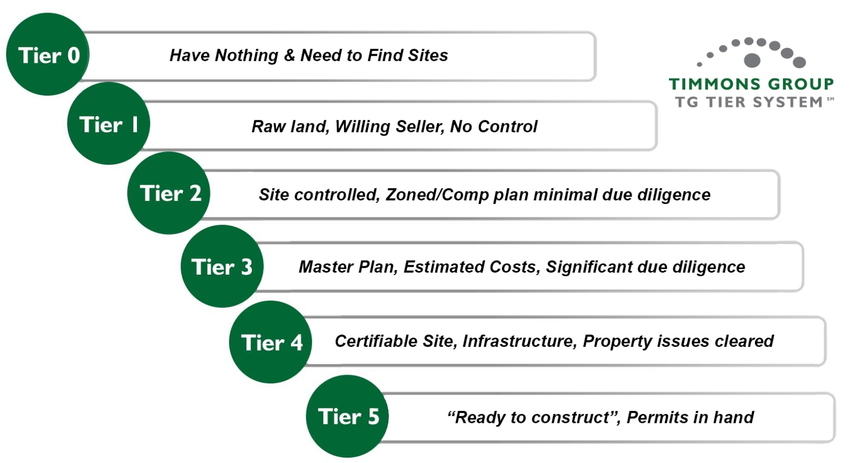
Major Considerations – Site Development
Site Selection / Identification
Site Negotiation
Site Control / Zoning
Master Plan / Due Diligence
Market
Demand
Infrastructure <12 mo
Infrastructure <12 mo
Shovel / Pad Ready
Notes:
In our tiering system, we have outlined the Major Considerations for each tier.
After we rolled out the system, we had several people tell us they didn’t have anything, therefore where would that place them. Being responsive to the market we added a “Tier 0”, which essentially means “I have nothing and need to find sites”, so this becomes “Site Identification”
Tier 1 is Site negotiation, which means you have raw land with a willing seller but no control
Tier 2 is Site Control / Zoning, which means you’ve either negotiated an option agreement or have purchase the project (i.e. have the site under control), you have it in the comp plan and/or zoned it industrial or business and have done minimal due diligence
Tier 3 is the Planning / Due Diligence stage – You’re in the process of completing a Master Plan for the site, estimating your potential development costs, and performing significant due diligence such as geotech, wetlands delineation, cultural resources, etc.
Up to a Tier 3, other than land acquisition, your $/acre investment has been minimal, maybe $4,000-6,000 per acre.
Tier 4 is where you make the “Big Jump” from an investment perspective, and dependent upon the site location, available infrastructure, you could spend anywhere from $30,000 to 60,000 per acre at this point in time
Tier 5 is where you make the investment to clear the site and create a “Shovel Ready” or “Pad Ready” site and can cost between $15 to 30k per acre

Slide 69
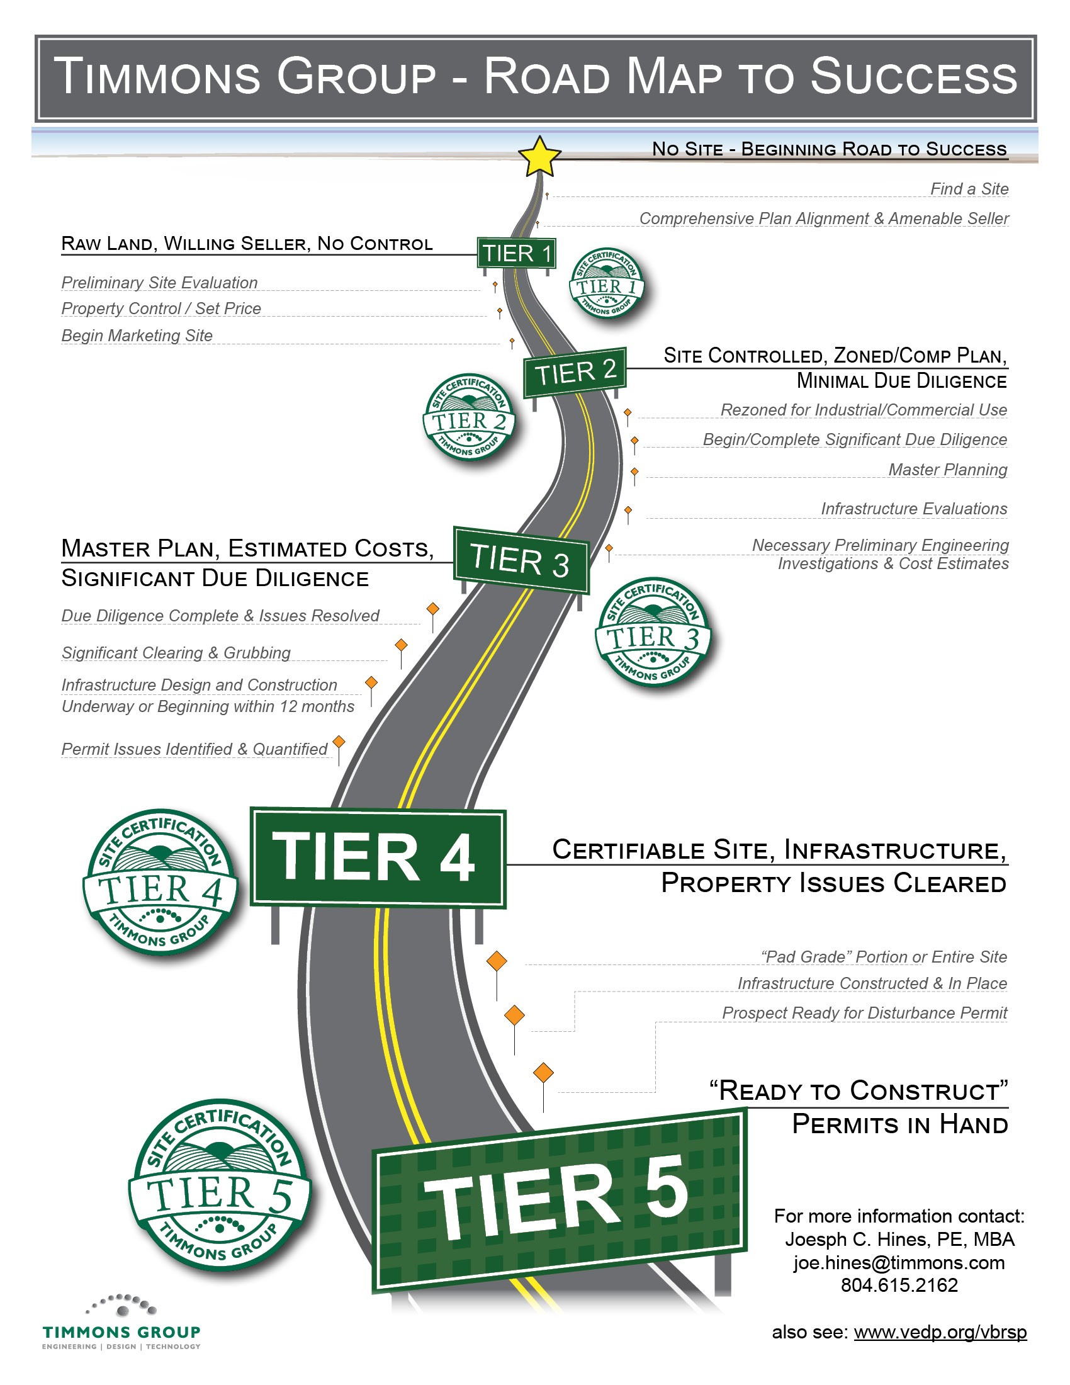

Site Readiness Road Map to Success
Tier 4 brings Certainty, and Certainty brings Business.
TIME > MONEY
& Competitive Advantage
in Site Selection

Slide 70
Typical Costs & Timelines to increase “Odds of Success”
100+ acre sites
Tier | Develop Timeline | Odds of Success | Prospect Readiness | Major Considerations | Typical Financial Investment
0 | 6-10+ yrs | 0% | No | Need to find sites | $20k to $100k+ (Local or Regional)
1 | 4-8 yrs | < 10% | No | Willing Seller | Minimal / Property Negotiation
2 | 3-6 yrs | < 20% | No | Site Controlled / Zoned | Option Agreements or Site Acquisition
3 | 12-36 mo | 40-50% | Minimum | Master Planning / Due Diligence | $100k to $250k+ $500 - $1,500/Acre
4 | 9-12 mo | 70-80% | Preferred | Infrastructure / Certifiable | $5 to $50+ million Geography / location
5 | 3-9 mo | > 90% | Preferred | Shovel / Pad Ready | $50k to $150k/Acre Geography / location
Notes:
“Gamblers odds”
Professional gamblers have an approach that they need to win 2 out of 3 times (or 60-70% of the time) to come out ahead. Based upon our Tiering system, we have assigned development timelines and odds of success (Success being defined as becoming a finalist site)
We assigned the tiers based upon the development timeline, and odds of success
Tier 1 -

Slide 71
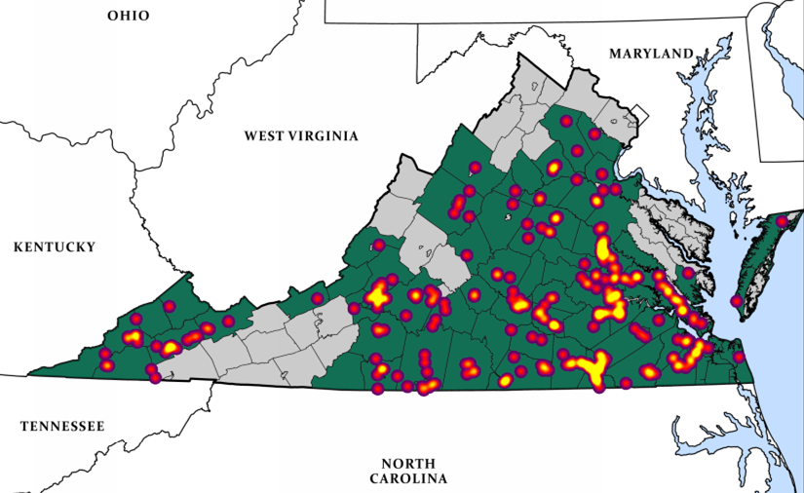
Timmons Group Experience
Site Assessments & Evaluations across Virginia
Reinvent Hampton Roads Site Assessment
Virginia’s Growth Alliance
Central Virginia Partnership for Economic Development
Roanoke Regional Partnership / WVRIFA
Virginia’s Coalfield EDA
Commonwealth Regional Council
Invest Southern Virginia (Mid-Atlantic Broadband)
Site Search for Virginia Beach Cable Landing Station
Dominion – Data Center Site Certification

Slide 72
By the numbers
Direct Tier Evaluations – Ranging in size from 10 acres to 1,000+ acres
  160+ Public & Private – Not all are 25+ acres and not all are in Va Scan
  ~70% were Private and 30% Public
  ~65% were Tier 2
  ~26% were Tier 3
  ~5% were Tier 4
  ~4% were Tier 5
GIS Site Selection Evaluations
  ~75% were Tier 1 – Needed Comp Plan & Zoning Adjustments
  ~20% were Tier 2 – Lacking Due Diligence Predominantly
Over 280 Econ Dev related Site Assessments & Site Evaluations
  Over 80% sites were Private
Multiple clients are
advancing sites

Slide 73

Project Example – Hampton Roads Site Assessment
Site | Locality | Overall Rating | Tier | Tier 3 Estimate* | Tier 4 Estimate | Tier 4 Timeline
14. HRC North Campus | Hampton | A | 2 | $168,500 | $2,500 | 4-6 mo
19. Holland Intermodal Ph II | Isle of Wight | A | 2 | $147,000 | $3,500 | 4-6 mo
21. Westport | Suffolk | A | 2 | $41,500 | $3,500 | 4-6 mo
23. BASF Site | Suffolk | A | 2 | $89,500 | $2,500 | 4-6 mo
26. TCC Property | Suffolk | A | 2 | $88,250 | $2,500 | 4-6 mo
27. Suffolk #1 | Suffolk | A | 2 | $179,000 | $2,500 | 4-6 mo
30. Northgate Commerce Park | Suffolk | A | 2 | $184,500 | $2,500 | 4-6 mo
31. Corporate Landing Bus Park | Va Beach | A | 2 | $97,600 | $2,500 | 4-6 mo
5. CW Foundation #1 | York | A | 2 | $119,000 | TBD w/ PER | 12-18 mo
6. CW Foundation #2 | York | A | 2 | $140,500 | TBD w/ PER | 12-18 mo
13. Air Commerce Park Ph II | Newport News | B | 2 | $105,000 | TBD w/ PER | 12-18 mo
22. Waverton Commerce Park | Suffolk | B | 2 | $180,000 | TBD w/ PER | 12-18 mo
28. Suffolk #2 | Suffolk | B | 2 | $115,000 | TBD w/ PER | 12-18 mo
29. Suffolk #3 | Suffolk | B | 2 | $199,400 | $2,500 | 4-6 mo
7. Egger Property | York | B | 2 | $177,000 | TBD w/ PER | 12-24 mo
8. Kings Creek Com Center | York | B | 2 | $187,500 | TBD w/ PER | 12-24 mo
25. Ballard Farm | Suffolk | B / C | 2 | $234,100 | TBD w/ PER | 12-24 mo
24. Nahra Farm | Suffolk | D | 2 | $125,500 | TBD w/ PER | 12-24 mo
9. Skiffes Creek Parcel | James City | No Add'l Work | 2 | $104,000 | $2,000 | 4-6 mo
* Note: Tier 3 Estimates could change should additional Due Diligence Work be discovered (i.e. Boundary or Topo Survey, Ph 1 ESA, etc.)

Slide 74
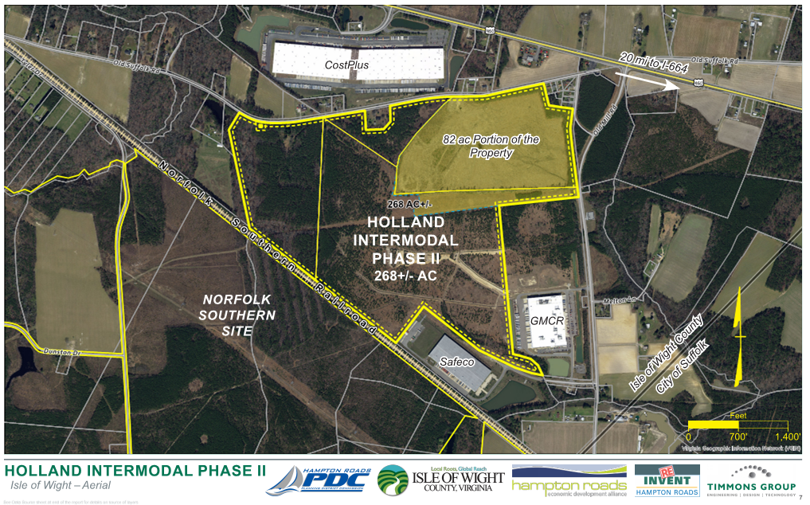
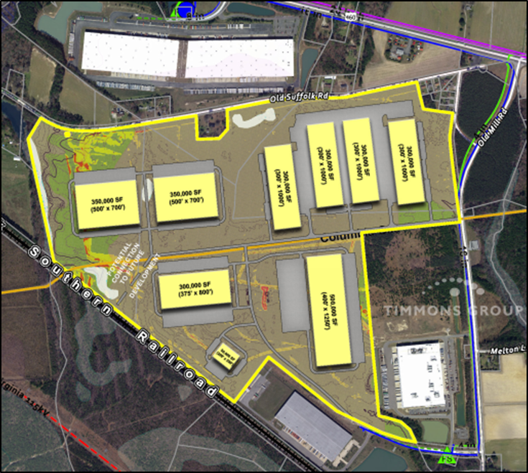
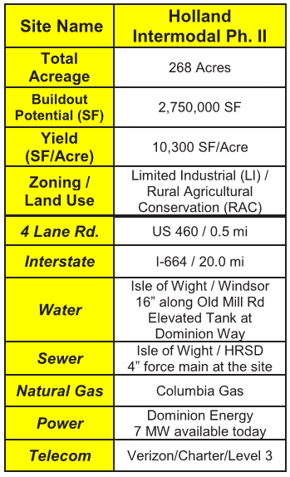
Holland Intermodal – an “A” site in Isle of Wight
Site Assets:
Access to Transportation (US 460)
Access to Key Utilities
Great Site Yield (SF/Acre)
Power & NG Availability

Slide 75

Key Take Aways
Not all sites are created equal – Need “Smart Data”
Most sites are lacking key due diligence (i.e. Site “Eliminators”)
Different Regions have different Development Issues
Assessing Tier 4 costs might require additional work beyond assessment
  Some sites need preliminary engineering to determine key infrastructure COSTS and TIMELINES to deliver a Tier 4 site (i.e. VDOT Coordination, etc.)
Site & Infrastructure Development is a Complex and Expensive process, however, is CRITICAL to Economic Development Success
GO Virginia plays a critical role in Site & Infrastructure Development
  $2.2 million award for MAMaC to achieve Tier 4 Status

Slide 76

Thanks for GO Virginia’s Regional Support!
Contact info:
Joseph C. Hines, PE, MBA
Principal & Director of Economic Development
joe.hines@timmons.com
804.615.2162

Slide 77
VBRS Site Characterizations and Perspectives
GO Virginia Board of Directors
March 12, 2019
Carolyn A. Howard, PE
Vice President, Site Development & Infrastructure

Slide 78
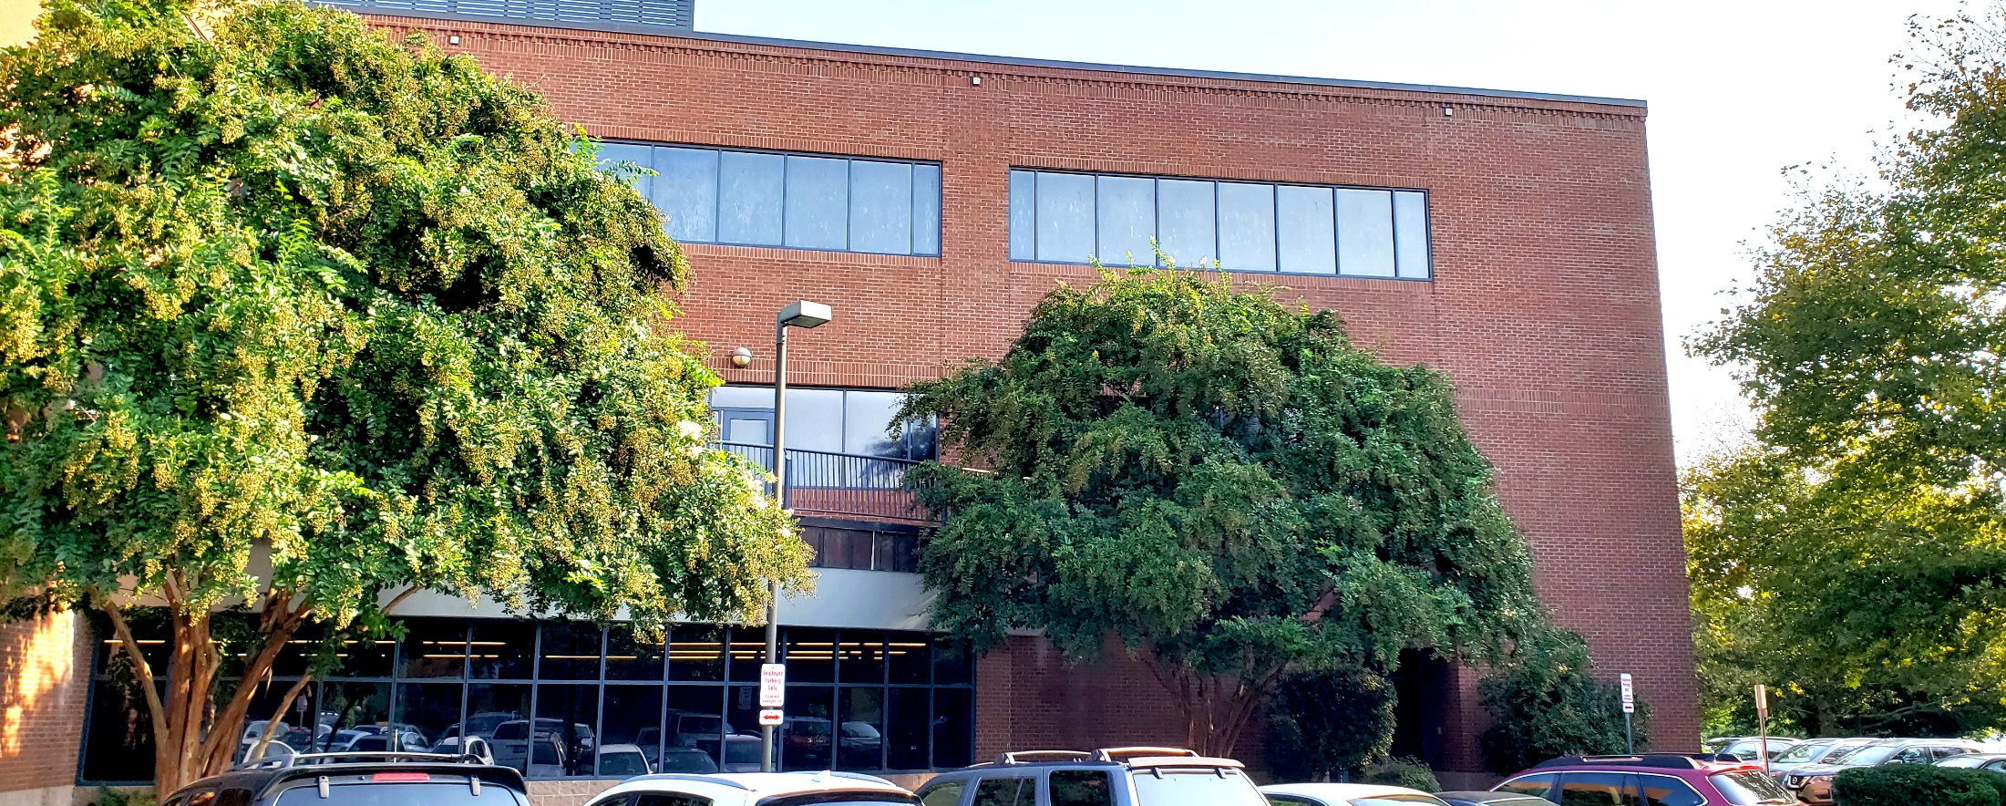
DAA Snapshot
Multi-discipline Consulting Firm
Blacksburg, Charlottesville, Richmond, Newport News, Manassas, and Virginia Beach, VA
Raleigh and Fayetteville, NC
45 Years of Experience

Slide 79
Carolyn Howard, PE
Regional Manager, Site Development and Infrastructure Division
B.S., Civil Engineering, Valparaiso University
27 years experience
Industrial Park Design
Economic Development Site Design
Provided VBRS Characterizations at 85% of Draper Aden’s sites.

Slide 80
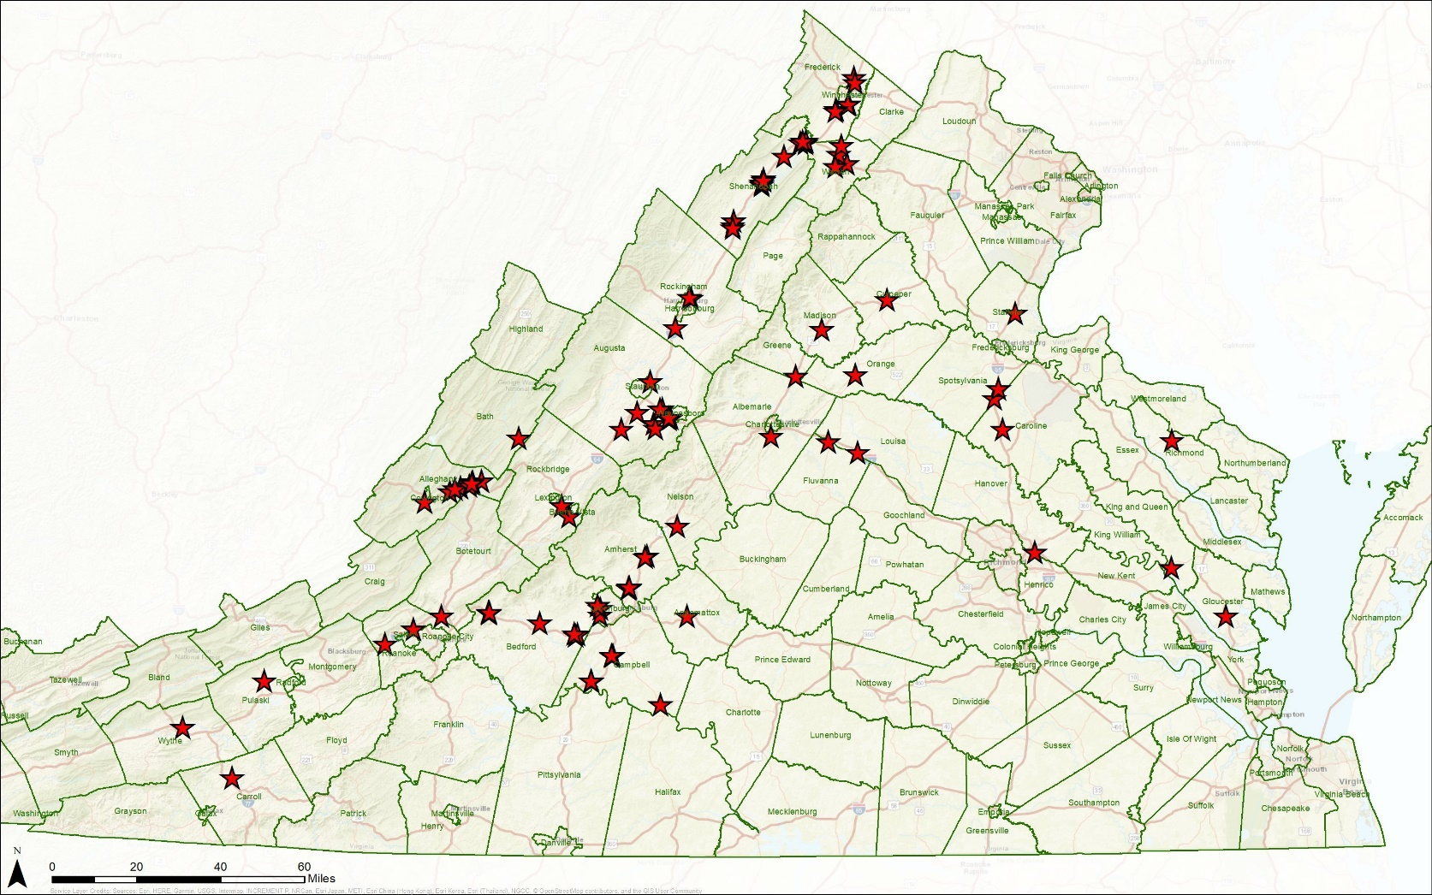
VBRS Characterizations

Slide 81
VBRS Characterizations
Tier Level | # Sites | Acreage Range | Average Acreage | Total Order of Magnitude Cost Estimate (to Tier 5)
1 | 18 | 12 – 1020 | 203 | $100,000,000
2 | 66 | 3 – 800 | 115 | $180,000,000
3 | 8 | 57 – 273 | 160 | $70,000,000
4 / 5 | 6 | 17 – 498 | 195 | $30,000,000
5 | 4 | 5 – 273 | 83 | $0
Totals | 102 |  |  | $380,000,000***
***Does not include all infrastructure costs

Slide 82
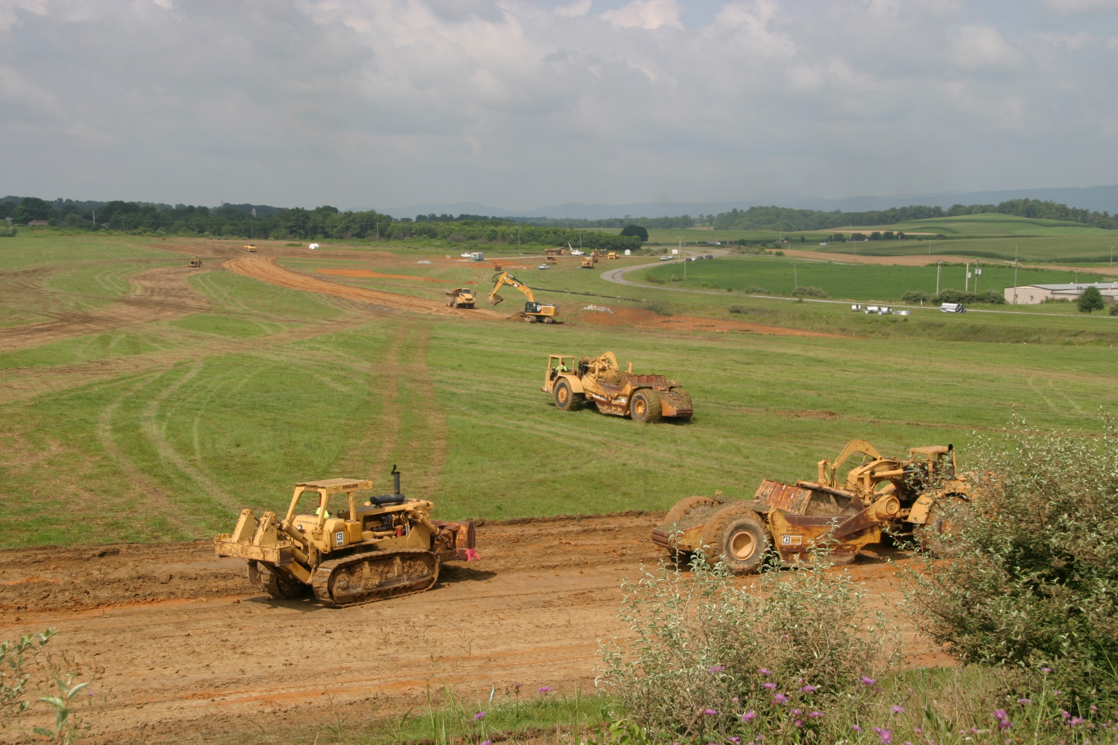
Site Characterization Insights
(Lessons Learned)
True cost estimates for advancement to Tier 5 are really unknown.
    Road improvements
    Utility extensions
Many sites at Tier 2 or Tier 3 require minimal investment to advance.
  Ex: Tier 2 site needed Cultural Resources to advance to Tier 4
VBRS Characterizations Value: Informs elected officials and private landowners about the difference between “land” and “sites.”

Slide 83
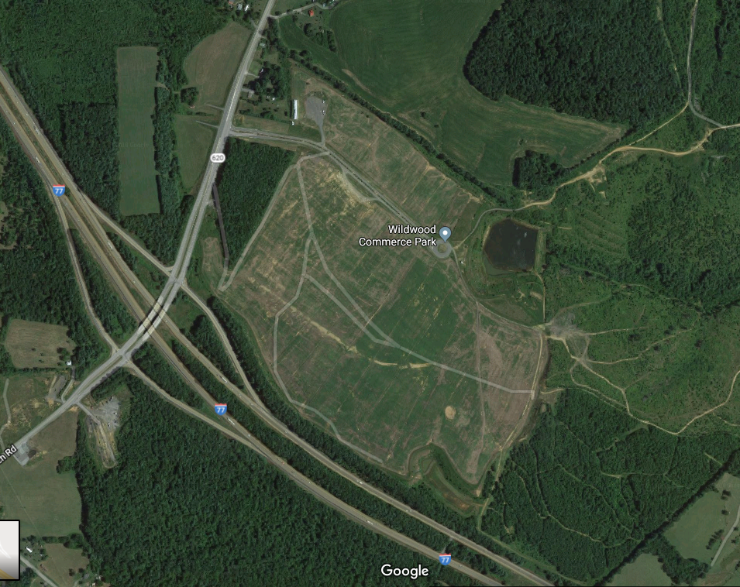
Perspectives for Further Site Development
Few Regional Projects: 7% of DAA characterizations are for regional sites/ projects.
Local Governments see the value of VBRSP characterizations: Very few of DAA’s projects were funded through VBRS.

Slide 84
Questions?
Carolyn A. Howard, PE choward@daa.com
540-552-0444

Slide 85
2019 Board Schedule

Slide 86
Tuesday, June 11, 2019
Tuesday, September 10, 2019
Tuesday, December 10, 2019
2019 Board Schedule

