Slide 1



Program Performance and Evaluation Commitee
COgro Labs at Virginia Tech Corporate Research Center (Source: GO Virginia Region 2 Annual Report)
March 24, 2026
In-Person

Slide 2

Agenda
OPENING
  Call to order
  Roll Call
  Public Comment
CONSENT AGENDA – Action Item
  Approval of March Meeting Minutes
GO VIRGINIA PROGRAM PERFORMANCE DASHBOARD
CONTRACT COMPLIANCE OF PROJECTS
JLARC RECOMMENDATION #4 – ASSESS LONG-TERM IMPACTS – Action Item
  GO Virginia Project Impact Issuance of Request for Proposal (RFP)
JLARC RECOMMENDATION #12 – RETURN ON INVESTMENT (ROI) DISCUSSION
  Award Threshold Determination
  ROI Determination Methods
    Current ROI Template – Fiscal Impact Calculator
    Third-party Evaluation Experience
    Break Even Analysis Tool
ADJOURNMENT

Slide 3
Program Performance and Evaluation Committee
GOALS and OBJECTIVES
Program Evaluation Committee Description (Bylaws)
The Program Evaluation Committee shall ensure that projects approved by the GO Virginia Board are meeting Board established criteria and are consistent with the GO Virginia mission by conducting a semiannual review of funded projects; assessing program performance, ensuring contract compliance of projects; and identifying projects that are scalable.
Review JLARC report recommendations consistent with the committee’s stated purpose, advance recommendations for response to the Board, and ensure the timely and efficient implementation of any program changes.

Slide 4
II. CONSENT AGENDA – Action Item a. Approval of February 5, 2026 Meeting Minutes

Slide 5
III. GO VIRGINIA PROGRAM PERFORMANCE DASHBOARD
https://public.tableau.com/app/profile/virginiadhcd/viz/GOVADashboard_17345526597200/GOVADashboard

Slide 6
IV. CONTRACT COMPLIANCE OF PROJECTS
Compliance requirements in the contract
  Quarterly reporting allows Regional Council to monitor progress towards goals and reports are reviewed/accepted by DHCD staff
  Fiscal monitoring through reimbursable remittances
There are currently 91 active projects.
Since the beginning of fiscal year 2026 (July 1, 2025), DHCD has processed the following:
  272 project remittances for a total of $16.6M
  250 quarterly reports
  36 performance closeout reports

Slide 7
V. JLARC Recommendation Discussion a. JLARC Recommendation #4 – Assess Long-term Impacts
Recommendation Policy Consideration Number | JLARC Report Recommendation | JLARC Reasoning For Recommendation
4 | The GO Virginia Board should develop and implement a policy to assess the long term impact of individual projects and the GO Virginia program as a whole, including which information should be collected to facilitate this long-term assessment. The board's actions should proceed under the guidance of its new project [program] evaluation committee and with the assistance and input of Department of Housing and Community Development staff and regional council support staff. | There is limited collection and evaluation of outcomes beyond the two-year grant period, even though GO Virginia has been characterized as a long-term program. The Code vests the GO Virginia board with the power and duty to assess the program's longer term impact, and many GO Virginia projects remain active after the grant period and produce valuable outcomes.

Slide 8
V. JLARC Recommendation #4 – Assess Long-term impacts a. GO Virginia Project Impact Issuance of Request for Proposal (RFP)
The Virginia Growth and Opportunity Board should develop and implement a policy to assess the long-term impact of individual projects and the GO Virginia program as a whole, including which information should be collected to facilitate this long-term assessment. The board’s actions should proceed under the guidance of its new project evaluation committee and with the assistance and input of Department of Housing and Community Development staff and regional council support staff.

Slide 9
VI. JLARC Recommendation #12 – Return on Investment (ROI) Discussion a. Award threshold determination b. ROI determination methods i. Current ROI template – fiscal impact calculator ii. Third-party evaluation experience iii. Break Even analysis

Slide 10
JLARC Recommendations for Review b. JLARC Recommendation #12 – Return on Investment (ROI)
Recommendation Number | JLARC Report Recommendation | JLARC Reasoning For Recommendation
12 | The GO Virginia board should revise its policies to clarify that only grant applications that would require a significant investment of state funds are required to include an estimated return on investment (ROI). The ROI should be tailored to each project and calculated by experienced professionals using established methodologies, and the costs should be paid for by the GO Virginia program out of its existing fund balances. | ROI is of limited value for measuring the potential impact of most GO Virginia projects, but it is reasonable to calculate an ROI for larger projects that receive a significant investment of program funds. The current approach, which relies on inexperienced applicants using a generic template to estimate their own ROI, does not result in realistic or useful ROI calculations. By comparison, VEDP calculates ROI for its site development projects, not the applicants.

Slide 11
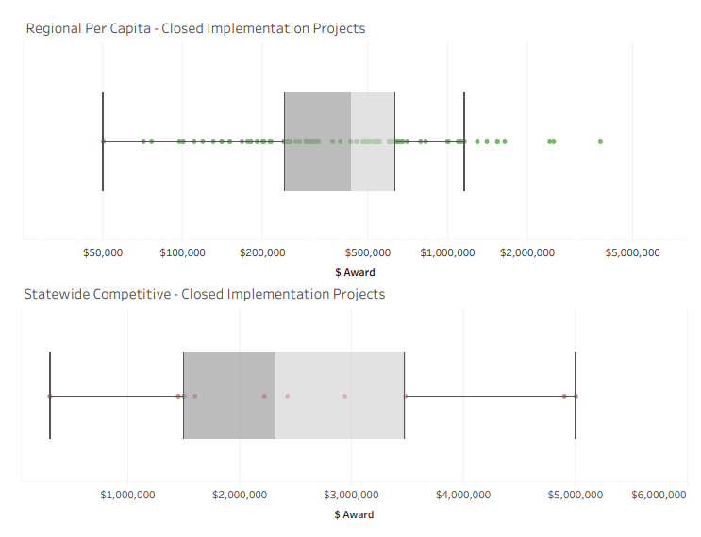
Award Threshold Determination
Per Capita Grant Award Analysis:
Per Capita Closed Projects Over $430,000 or $500,000
Average Award - $544,489
Total Award - $56,082,316
Regional Per Capita
Upper Whisker |  | $ 1,150,571
Upper Hinge |  | $ 631,946
Median |  | $ 430,000
Lower Hinge |  | $ 242,246
Lower Whisker |  | $ 50,000
Statewide Competitive
Upper Whisker |  | $ 5,000,000
Upper Hinge |  | $ 3,474,821
Median |  | $ 2,321,019
Lower Hinge |  | $ 1,500,000
Lower Whisker |  | $ 302,536
Competitive Grant Award Analysis:
Competitive Projects Over $1,500,000 or All Competitive
Average Award - $2,580,274
Total Award - $25,802,738

Slide 12
Current ROI Template
Why/How it’s Used in Evaluation & How it’s Calculated
The Return on Investment Calculator is dependent on two inputs and measured over 3- and 5-year intervals.
It assumes a level of job growth expected to occur in the targeted industry as a result of the project for all investment categories.
It is a fiscal return to the Commonwealth calculator that estimates state revenue increases – income and sales taxes for the job growth impact.
Inputs required for the model:
  Jobs Created
  Wages of Jobs Created

Slide 13
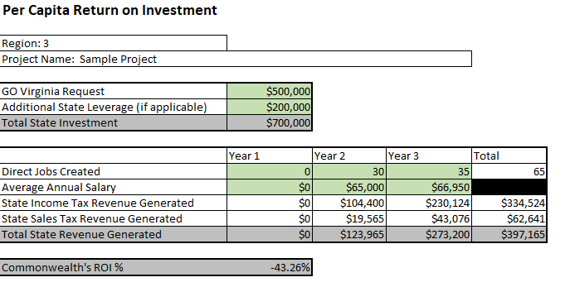
Current ROI Template
Example of current 3-year ROI used

Slide 14
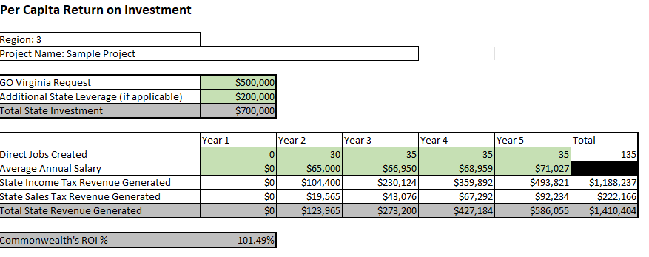
Current ROI Template
Example of current 5-year ROI used

Slide 15
Current ROI Template
Why/How it’s Used in Evaluation & How it’s Calculated
As a measure of economic impact, it is one of several ways a project application can demonstrate impact
1. Overview of project
2. Industry Focus and Support of Growth and Diversification Plan Strategies
3. Products, Outcomes, and Deliverables
4. Economic Impact Template - Please note that the template is used as one of many evaluation criteria, but a positive fiscal return in the 3- or 5-year impact study period is not an eligibility requirement.

Slide 16
Third-party Evaluation Experience
Up until (FY25), a third-party was required to validate the inputs used by the applicant in the ROI analysis for all Competitive applications, and developed a more comprehensive economic impact model.
Challenges: Some confusion regarding when and how to engage the consultant, delays in input validation, and final work product to accompany the application.

Slide 17
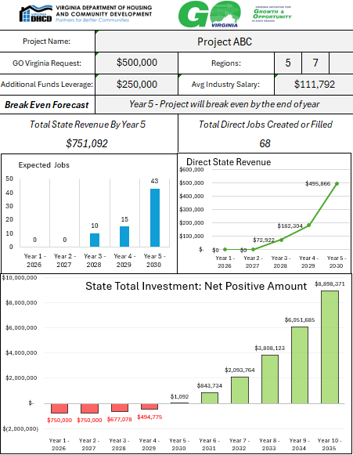
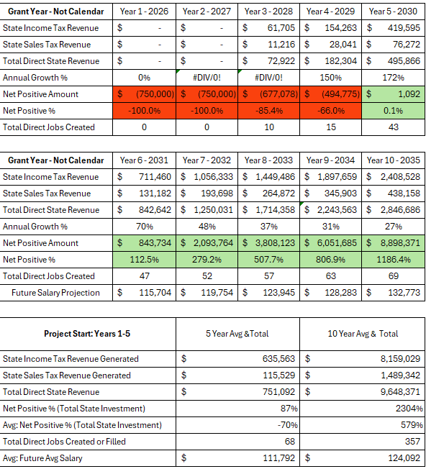
Break Even Analysis Tool

Slide 18
Discussion
Does the committee want to advance a recommendation related to either subpart of this JLARC study recommendation?
Should the program define an award level where an ROI calculation is required?
Who should perform it?
  Applicant using existing model with their inputs (Current Method)
  Staff using existing model with applicant inputs
  Third Party using applicant inputs ($)
  Staff using enhanced model (break-even analysis tool)

Slide 19
VII. NEXT MEETING (in-person) a. Virtual Meeting TBD

Slide 20
Adjournment

