Slide 1



Program Performance and Evaluation Commitee
COgro Labs at Virginia Tech Corporate Research Center (Source: GO Virginia Region 2 Annual Report)
May 29, 2026
Virtual

Slide 2
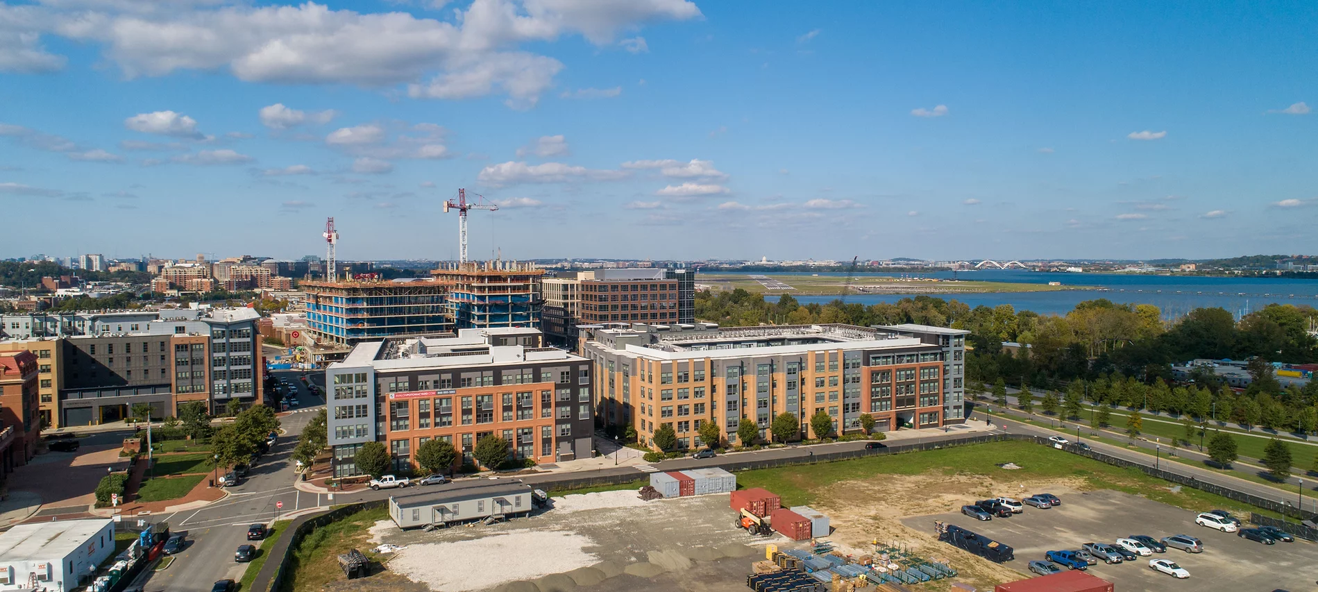
Agenda
OPENING
  Call to order
  Roll Call
  Public Comment
CONSENT AGENDA – Action Item
  Approval of March 24 Meeting Minutes
JLARC RECOMMENDATION #12 – Return on Investment Model – Action Item
  DHCD program guidelines and application amendments
  Award threshold determination – No threshold for Board approved projects
    State Fiscal Return Model
      Break Even Analysis Tool
        DHCD staff performed using applicant inputs
        Third-party evaluation if break-even is greater than 5 years
    Next Steps (Administrative Guidelines)
      Revised GO Virginia Core Outcomes Worksheet
      Outcome-to-Employment Conversion Methodology
FY26Q3 CLOSED PROJECT REVIEW
  Implementation
  Planning, Feasibility, and Small-Scale Pilot
PROJECT EVALUATION RFP UPDATE
NEXT MEETING
  In-Person meeting TBD
ADJOURNMENT

Slide 3
Program Performance and Evaluation Committee
GOALS and OBJECTIVES
Program Evaluation Committee Description (Bylaws)
The Program Evaluation Committee shall ensure that projects approved by the GO Virginia Board are meeting Board established criteria and are consistent with the GO Virginia mission by conducting a semiannual review of funded projects; assessing program performance, ensuring contract compliance of projects; and identifying projects that are scalable.
Review JLARC report recommendations consistent with the committee’s stated purpose, advance recommendations for response to the Board, and ensure the timely and efficient implementation of any program changes.

Slide 4
II. CONSENT AGENDA – Action Item a. Approval of March 24, 2026 Meeting Minutes

Slide 5
III. JLARC Recommendation #12 – Return on Investment (ROI) Model Discussion a. DHCD program guidelines and application amendments b. Award threshold determination – No threshold for Board approved projects b. Return on Investment (ROI) determination methods i. State Fiscal Return Model
1. Break Even Analysis Tool a. DHCD staff performed using applicant inputs b. Third-party evaluation if the break-even is greater than 5 years ii. Next steps (Administrative Guidelines)
1. Revised GO Virginia Core Outcomes Worksheet
2. Outcomes-to-Employment Conversion Methodology
3. Regional Training Q&A Sessions

Slide 6
JLARC Recommendations for Review b. JLARC Recommendation #12 – Return on Investment (ROI)
Recommendation Number | JLARC Report Recommendation | JLARC Reasoning For Recommendation
12 | The GO Virginia board should revise its policies to clarify that only grant applications that would require a significant investment of state funds are required to include an estimated return on investment (ROI). The ROI should be tailored to each project and calculated by experienced professionals using established methodologies, and the costs should be paid for by the GO Virginia program out of its existing fund balances. | ROI is of limited value for measuring the potential impact of most GO Virginia projects, but it is reasonable to calculate an ROI for larger projects that receive a significant investment of program funds. The current approach, which relies on inexperienced applicants using a generic template to estimate their own ROI, does not result in realistic or useful ROI calculations. By comparison, VEDP calculates ROI for its site development projects, not the applicants.

Slide 7
Application amendment
Current application modified to include the following language
Please attach the DHCD Economic Impact template that demonstrates the expected fiscal return to the Commonwealth. Please note that the template is used as an evaluation criterion but a positive fiscal return is not an eligibility requirement. Include an explanation and source any data used as the basis for inputs used to complete the template. ATTACHMENTS: The DHCD Economic Impact template should be uploaded with the application.

Slide 8
Award Threshold Determination
Staff Recommendation
DHCD staff evaluated past funded projects based on size and determined the most equitable approach was to apply a standard state fiscal return model uniformly across all implementation project sizes.

Slide 9
Return on investment (ROI) Determination Methods
Staff Recommendation
Adopt the State Fiscal Return Model
  Based on inputs provided by the applicant in the Revised GO Virginia Outcomes Worksheet
  Will reduce the burden on the applicant and simplify the application process
  DHCD staff will perform the analysis and convert these inputs into jobs based on the Outcome-to-Employment Conversation Methodology
  Will provide an estimate of the year the project is expected to have a positive return
  Addresses the JLARC concern regarding inexperienced applicants and the generic template
  For projects projected to have break-even more than five years out, a third-party evaluation will be sought to validate inputs and perform a more in-depth analysis

Slide 10
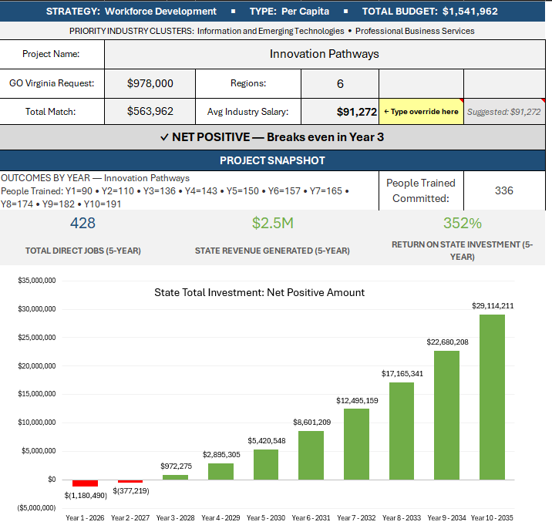
State Fiscal Return Model

Slide 11
State Fiscal Return Model - Implementation
Next steps (Administrative Guidelines)
DHCD staff will revise the GO Virginia Core Outcomes Worksheet to include committed outcomes by year 1-2 (performance period).
Outcome-to-Employment Conversion Methodology will be used to standardize how outcomes are converted to jobs (primary input for the calculator) based on nationally recognized sources.
Wages are determined using industry cluster averages. Clusters are characterized by regions in their G&D Plans.
Training Q&A sessions will be scheduled with regional support organizations.

Slide 12
IV. FY26Q3 CLOSED PROJECT REVIEW a. Implementation b. Planning, Feasibility, and Small-Scale Pilot

Slide 13
Closed Project Review
Highlights – FY26 - Q3
16 projects closed
8 implementation
8 planning/pilot/feasibility
Collective Impact
8 successfully completed planning/pilot efforts
8 completed implementation projects produced
730+ businesses served
2,000+ individuals trained
650 industry-recognized workforce credentials issued and 100 new apprentices placed
970+ acres of industrial sites advanced (including 134 acres newly certified at VBRSP Tier 3 and one site sold)
$6M+ in direct matching commitments secured
$48M+ capital raised by served business

Slide 14
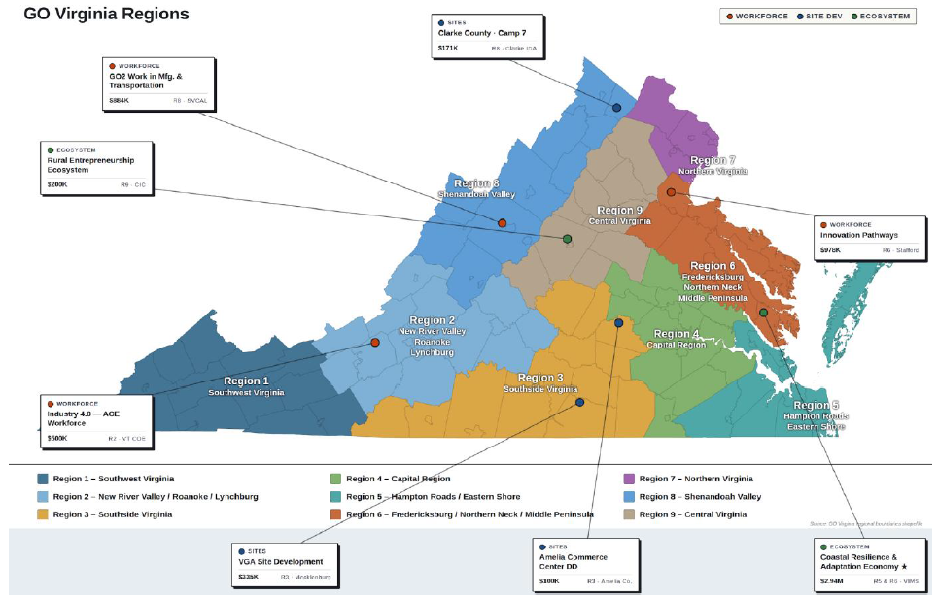
Closed Project Review
Implementation Projects

Slide 15
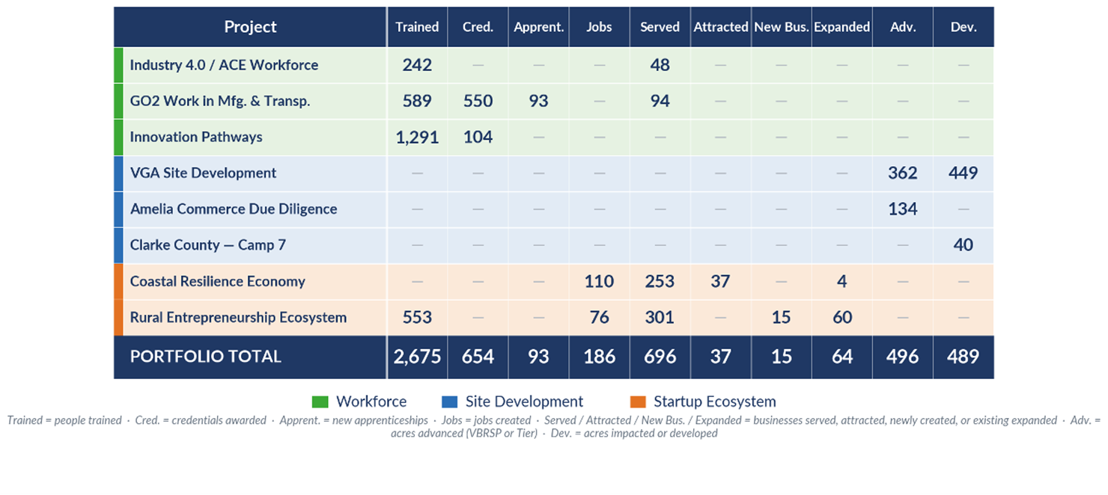
Closed Project Review
Implementation Project Outcomes Summary

Slide 16
Closed Project Review
Implementation Projects – Portfolio Snapshot
Green – all committed outcomes are met or exceeded
Yellow – Any outcome at 50-99%
Red – Any outcome at less than or equal to 49%

Slide 17
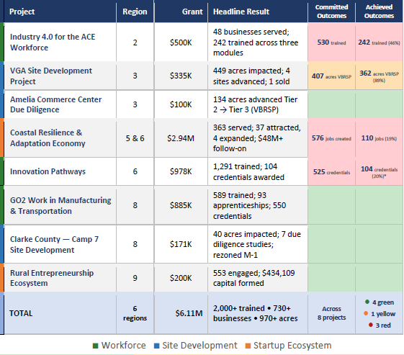
Closed Project Review
Implementation Projects Portfolio Snapshot

Slide 18
Closed Project Review
Implementation Projects – Portfolio Snapshot (cont.)
It should be noted, the three projects highlighted in red DO NOT mean the project was a failure but had one outcome where there was a significant shortfall. In some cases they significantly overachieved in other outcomes.
As an example, the Innovation Pathways project far exceeded the committed number of people trained at 1,291 (committed to 336), however, the credentials earned were 104 (committed 525). This was mainly due to high school students getting trained but not taking the test. The project team was still able to pivot and open up the training to adult learners or displaced workers who making career changes.

Slide 19
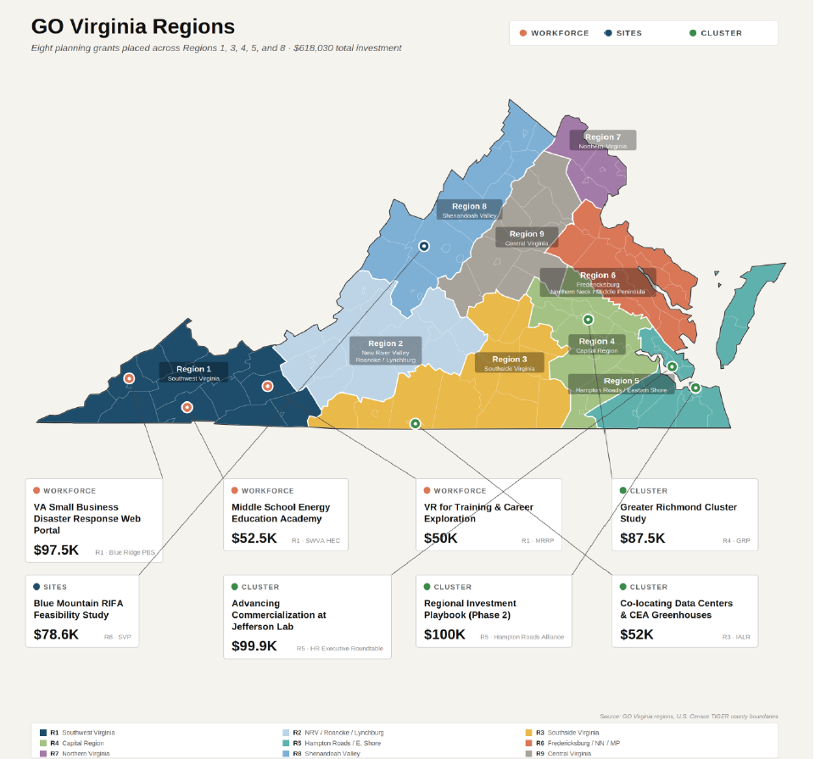
Closed Project Review
Planning Projects

Slide 20
Closed Project Review
Planning Projects – Portfolio Snapshot
Green – met all targets
Yellow – met 50% of targets
Red – met less than 50% of targets

Slide 21
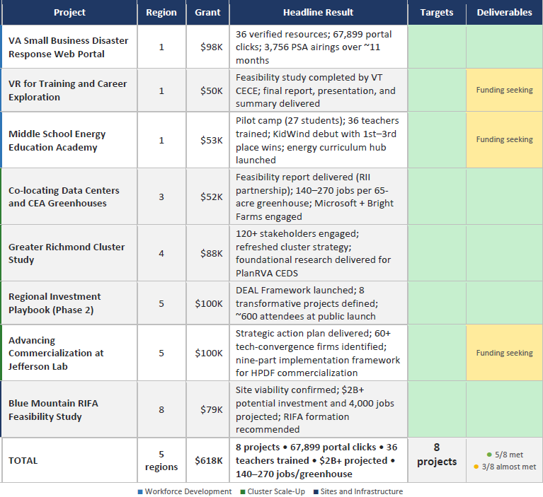
Closed Project Review
Planning Projects – Portfolio Snapshot (cont.)

Slide 22
Closed Project Review
Planning Projects - Key Takeaways
8 projects closed in 5 of the 9 GO Virginia Regions
  5 of the planning projects hit all of their target and are aligned with funding for future implementation projects
  3 of the planning projects are still seeking funding and do not currently have a line of sight to implementation.

Slide 23
V. PROJECT EVALUATION RFP UPDATE

Slide 24
VII. NEXT MEETING (in-person) a. Time and Location TBD

Slide 25
Adjournment

